Slide 1
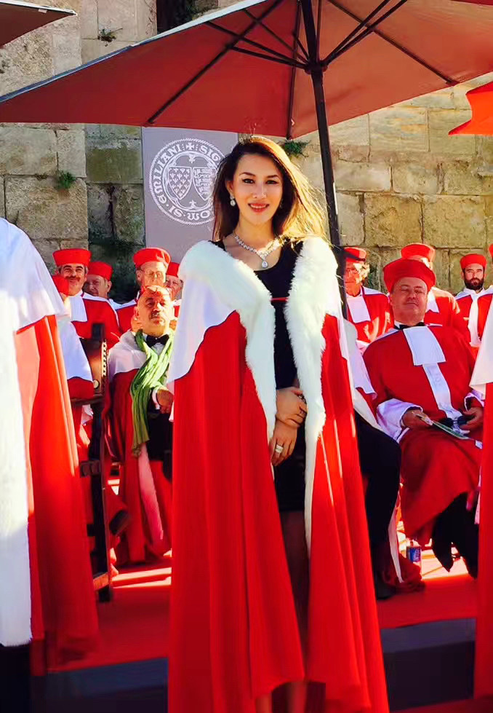
The Collective Emergence of Female Leaders as a Marker of Future Human Civilization
Rachel Yue
Assistant Researcher at the Columbia Research Center
Honorary Dame of the French Ordre des Roulades

