Slide 1
Deeply cultivating the field of waste tire recycling, supporting the development of global circular economy
深耕废旧轮胎回收领域，助力全球循环经济发展
Wang Duoxiao, founder of Mianyang Ruiyang New Materials Technology Development Co., Ltd.
绵阳锐洋新材料科技有限公司创始人 王多孝

Slide 2
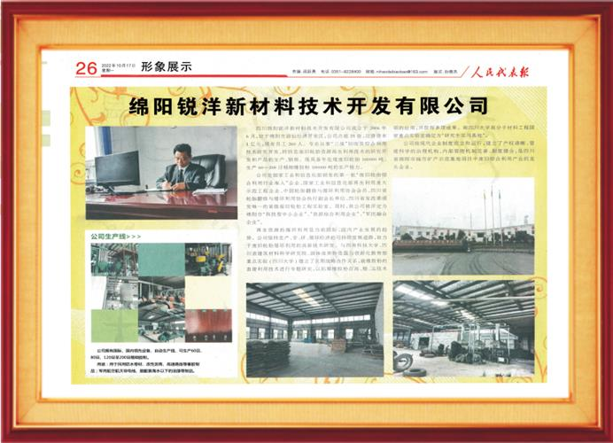
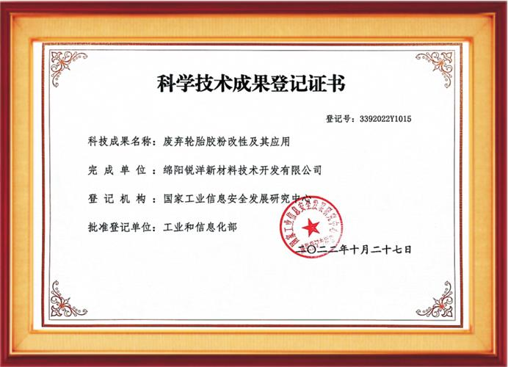
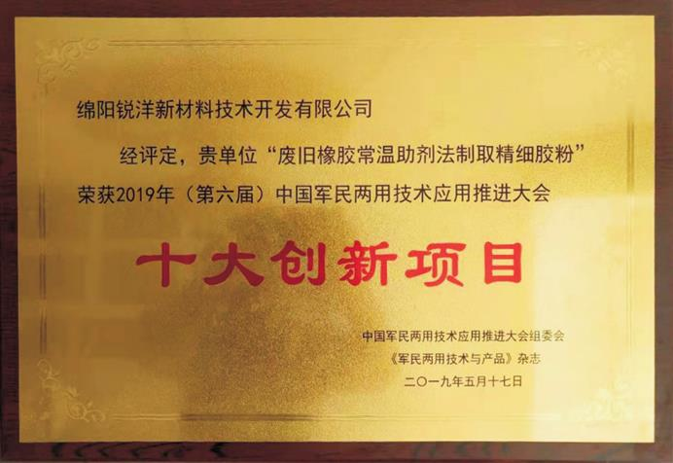
Company Profile
公司介绍
Mianyang Ruiyang New Materials Technology Development Co., Ltd. is a waste tire comprehensive utilization enterprise announced by the Ministry of Industry and Information Technology. It is also the largest waste tire recycling and modified rubber powder production enterprise in southwest China.
绵阳锐洋新材料技术开发有限公司是工业和信息化部公告的废轮胎综合利用企业，也是中国西南地区规模最大的废轮胎回收利用生产改性橡胶粉企业。

Slide 3
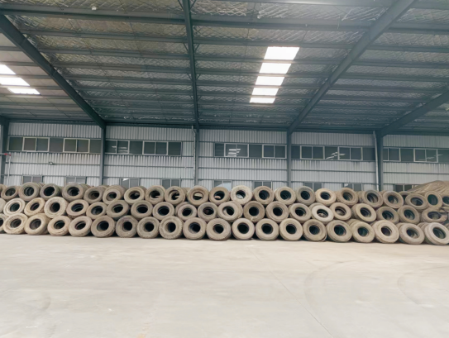
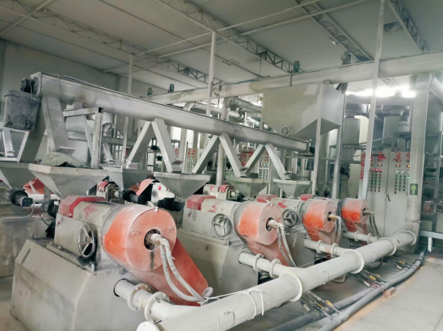
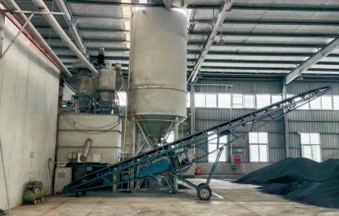
The main product is recycled rubber powder, covering 60 mesh, 80 mesh, 100-200 mesh and other series, which are widely used in waterproof membrane, asphalt modification, medical rubber gloves, home appliances, unmanned aircraft, aerospace and other fields.
公司主要产品为再生橡胶粉，涵盖了60目、80目、100-200目等多个系列，广泛应用于防水卷材、沥青改性、医用橡胶手套、家电、无人驾驶机、舰艇、航空航天等领域。

Slide 4
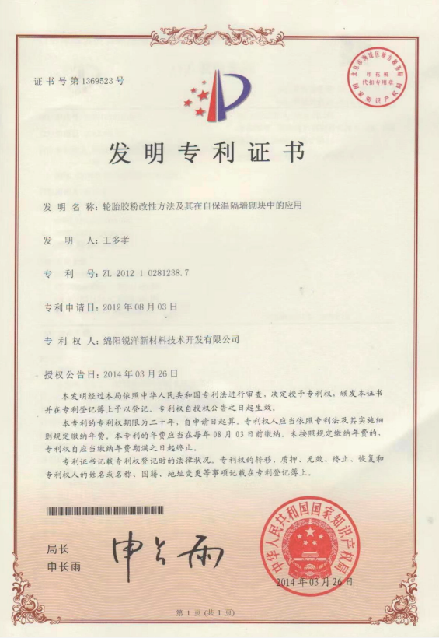
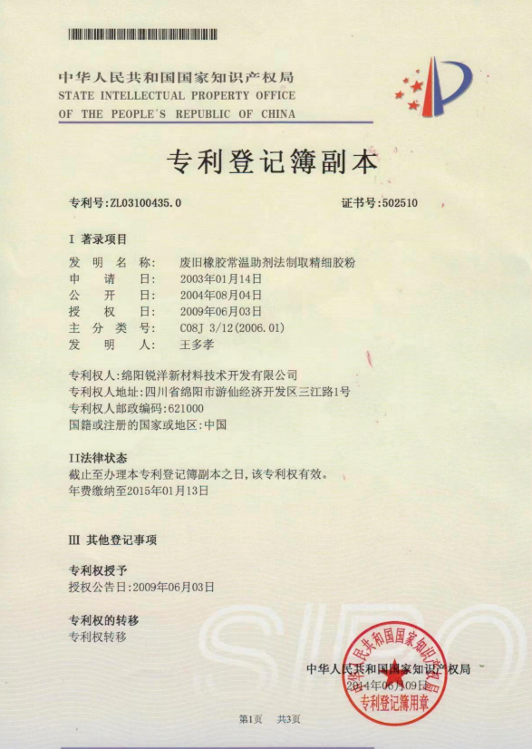
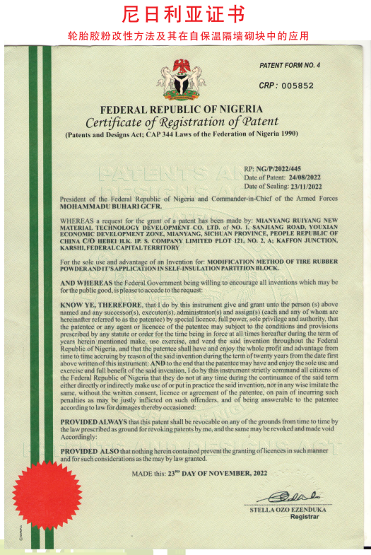
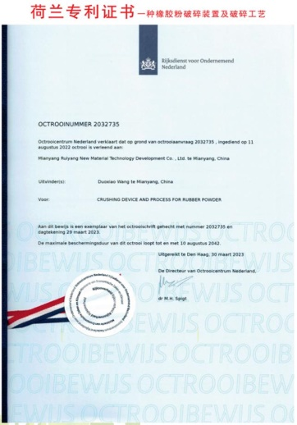
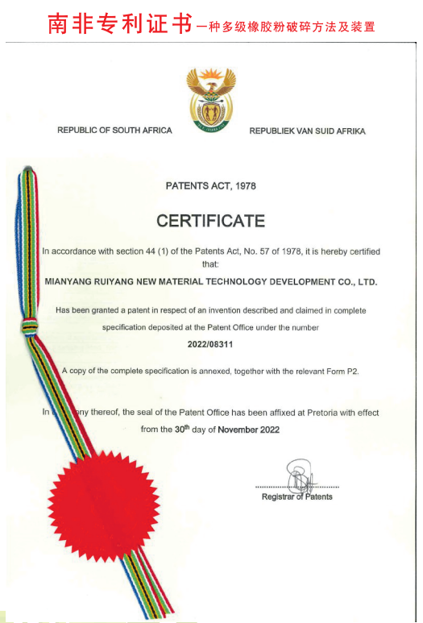
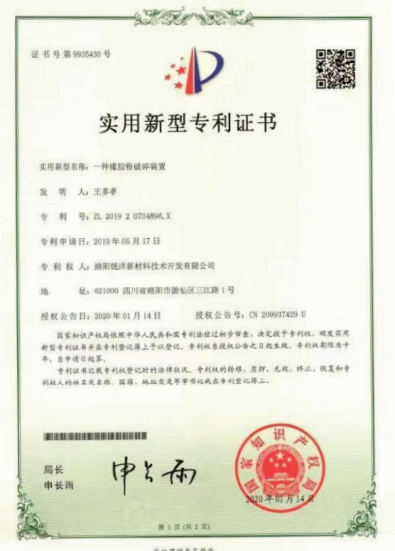
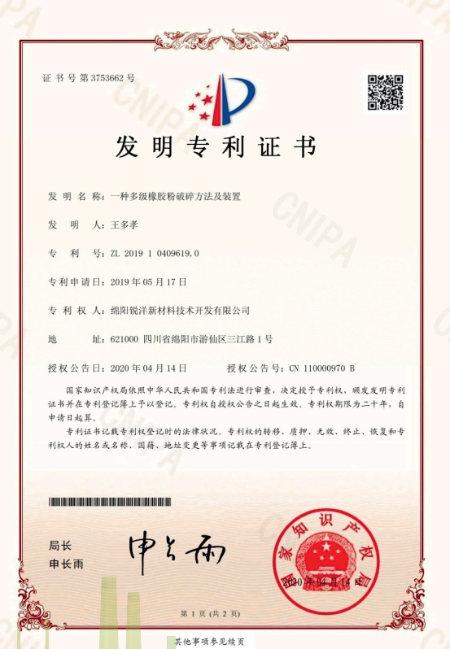
We have carried out joint research and development on key core technologies related to the preparation process of ultrafine rubber powder at room temperature, rubber powder modification, and application of modified rubber powder. We have achieved multiple scientific research results and obtained 4 invention patents. At the same time, it has gained recognition and access from multiple countries including the United States, the United Kingdom, the Netherlands, South Africa, and Nigeria.
围绕超细胶粉常温制取工艺、橡胶粉改性、改性胶粉应用等方面，开展关键核心技术产学研联合攻关，取得多项科研成果，获得发明专利4项。同时获得了美国、英国、荷兰、南非和尼日利亚等多个国家的认可与准入。

Slide 6
THANK YOU

