Slide 1
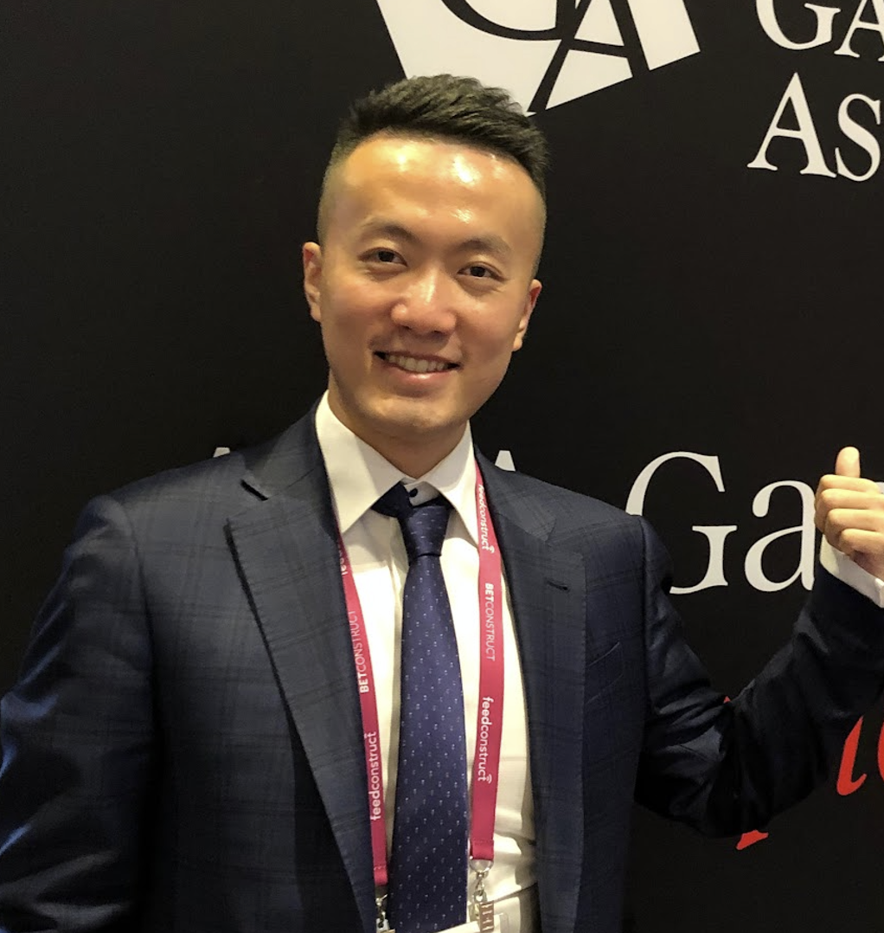
Carter Qiu
The Symbiosis of Web3 and AI: Reshaping the Future of Global Health and Philanthropy
Keynote Speaker:
Deputy Head of G20 YEA China Delegation
Formerly with Google and JP Morgan
Founder at Loop
Founder & CEO at TokenWin
Founder & CEO at MetaVegas
Pioneering blockchain solutions and innovation
in digital economy

