Slide 1
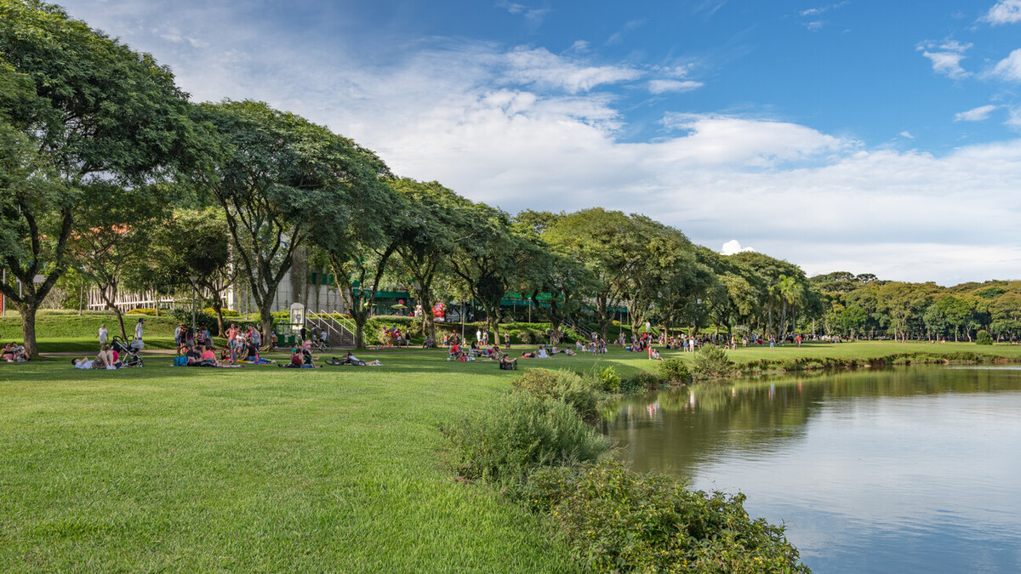
Nature-based solutions for urban resilience and sustainability
3 December 2023
GFHS 2023 - COP28
By Sachin Bhoite
Director of Climate Resilience
C40 Cities
Curitiba, Brazil © Rafael Serathiuk - Getty Images
Notes:
The suggested speech is on page 6, here of COP briefing

Slide 2
The C40 Cities network
A network of 97 cities led by Mayors
Directly representing 582 million residents
Influencing 896 million people

Slide 3
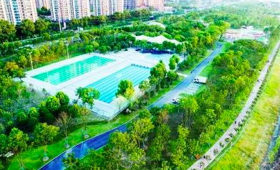
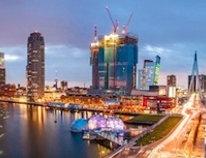
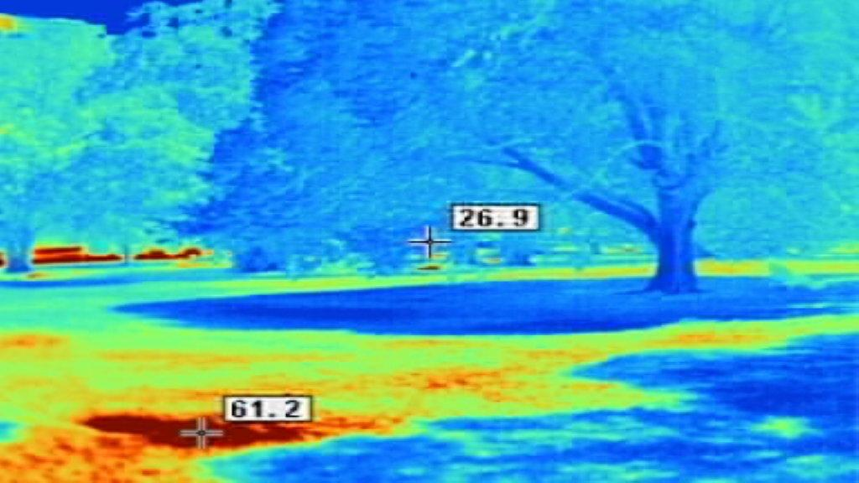
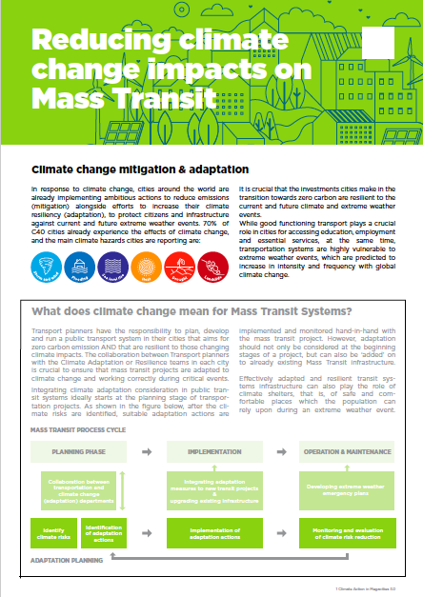
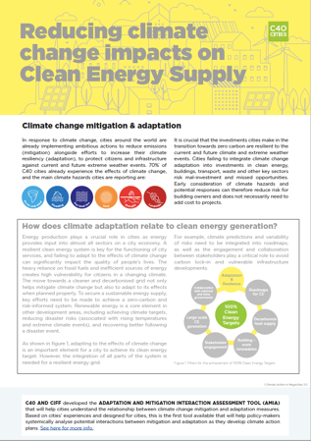
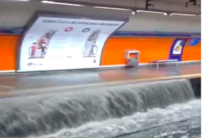
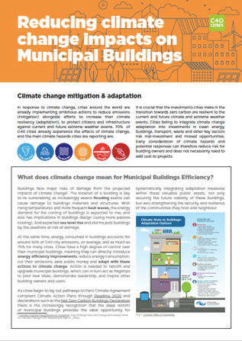
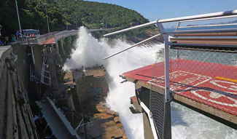
C40 Networks supporting Urban Adaptation
Urban Flooding Network
Water Security Network
Connecting Delta Cities Network
Cool Cities Network
To prevent/
reduce the impacts of

Slide 4
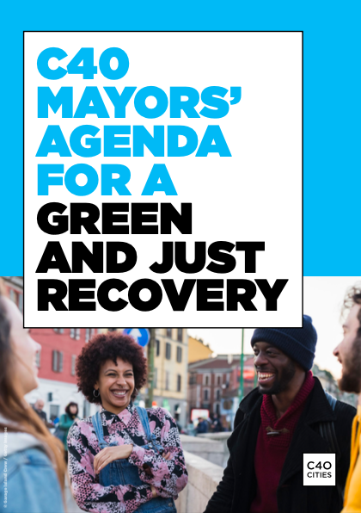
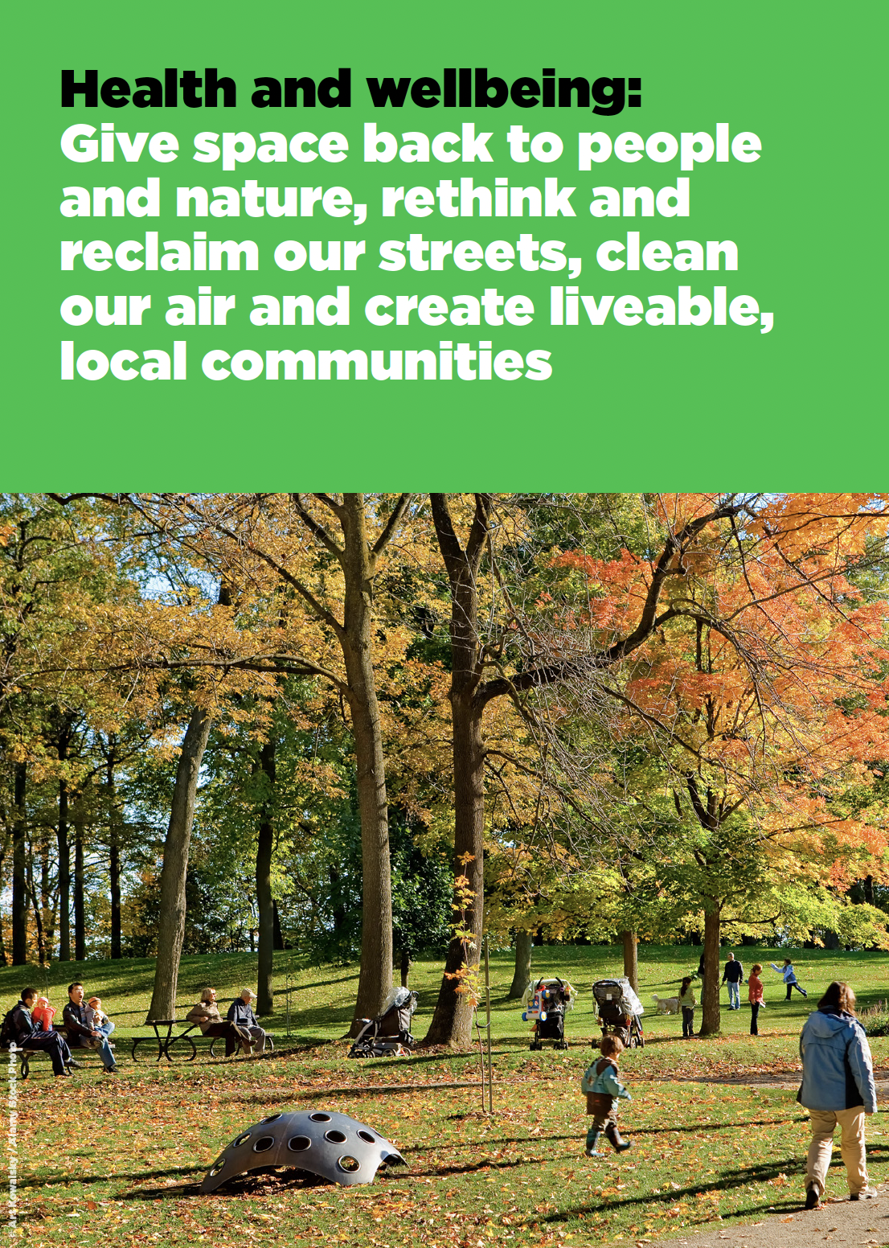

Slide 5
C40 Urban Nature Accelerator
Making our Cities Greener and More Resilient
Calling on cities to increase and enhance nature in their urban environments that reduces climate risk and vulnerability, supports wider ecosystem services, and is equitably distributed and publicly accessible, by 2030.
The objectives of this declaration are to set inclusive and equitable targets to develop living, climate-ready, and crisis-prepared cities.
Medellin © Ivan Valencia - AFP

Slide 6
Urban Nature Accelerator Signatories
41 cities to date
13
Amman, Athens, Barcelona, Berlin, Copenhagen, Haifa, London, Milan, Paris, Rome, Rotterdam, Stockholm, Tel Aviv
7
Austin, Los Angeles, Montréal, New Orleans,
San Francisco, Seattle, Toronto
3
Quezon City, Sydney, Tokyo
6
Chennai, Delhi, Dhaka North, Dhaka South, Mumbai
10
2
Durban, Freetown
Bogota, Buenos Aires, Curitiba, Guadalajara, Lima, Medellin, Quito,
Rio de Janeiro, Salvador, São Paulo
‹#›

Slide 7
The challenge
Cities occupy 2% of the world’s landmass
Cities are home to nearly
60% of the world’s population
Cities generate over 80% of the world’s GDP
Notes:
Global stat: “cities account for less than 2% of the Earth’s surface” & “cities consume and around 75% of the world’s energy” _ Source: UN Habitat (https://www.un.org/en/climatechange/climate-solutions/cities-pollution)
Global stat: “accounting for 71 to 76 percent of CO2 emissions from global final energy use” _ Source: UN Habitat (https://unhabitat.org/topic/climate-change)
“With more than 80% of global GDP generated in cities, urbanization can contribute to sustainable growth…” Source: World Bank, 2020 (https://www.worldbank.org/en/topic/urbandevelopment/overview#1)

Slide 8
Urban Nature Accelerator Pathways
PATHWAY 1:
QUALITY TOTAL COVER
Heat & Water related risk
PATHWAY 2:
EQUITABLE SPATIAL DISTRIBUTION
Accessibility and connectivity
30-40% of the total built-up city surface area is:
Green spaces
through street trees & urban forests, parks, gardens, building integrated vegetation
and/ or;
Permeable spaces
through green roofs, roads, pavements, green ground, infiltration trenches, swales, detention basins, regenerative urban agriculture
70% of the city population has access to a fit for purpose green and/or blue space within 15 minutes
Equitably prioritised to maximise connectivity and accessibility to nature for the most vulnerable
Notes:
Pathway 1 is most suitable for cities prioritising addressing the quantity of interventions for heat and water related risk in cities. Incorporating green spaces and permeable surfaces into urban landscape design is a solution that can help mitigate rising temperatures, as trees cool their surroundings via evapotranspiration and shading; and permeable surfaces increase infiltration of rainwater and have the effect of decreasing flood risk. Through this pathway cities aim to have majority of the proposed changes in areas of high vulnerability and should incorporate both Vertical and horizontal solutions. Where it is difficult for trees to grow and thrive, e.g. in arid climates, the target should be 30%-40% of vegetation. Greening and permeability interventions applied to the same surface area should be counted as a single intervention unless a city can demonstrate the interventions provide a duplication of benefits.
Pathway 2 is most suitable for cities with a priority on ensuring equitable spatial distribution and accessibility of their urban nature interventions. Green features such as city parks, street trees, and ponds are common tools used to bring nature into urban spaces, however there is evidence that urban green space benefits are not equitably distributed across diverse cities and urban populations. This pathway would address the issue of equity, and inclusion by setting cities on a pathway to achieve the “15-minute city.” The pathway will guide cities to take an approach to urban design that aims to improve quality of life by increasing connectivity and creating cities where a community can reach natural and natural spaces within 15 minutes.

Slide 9
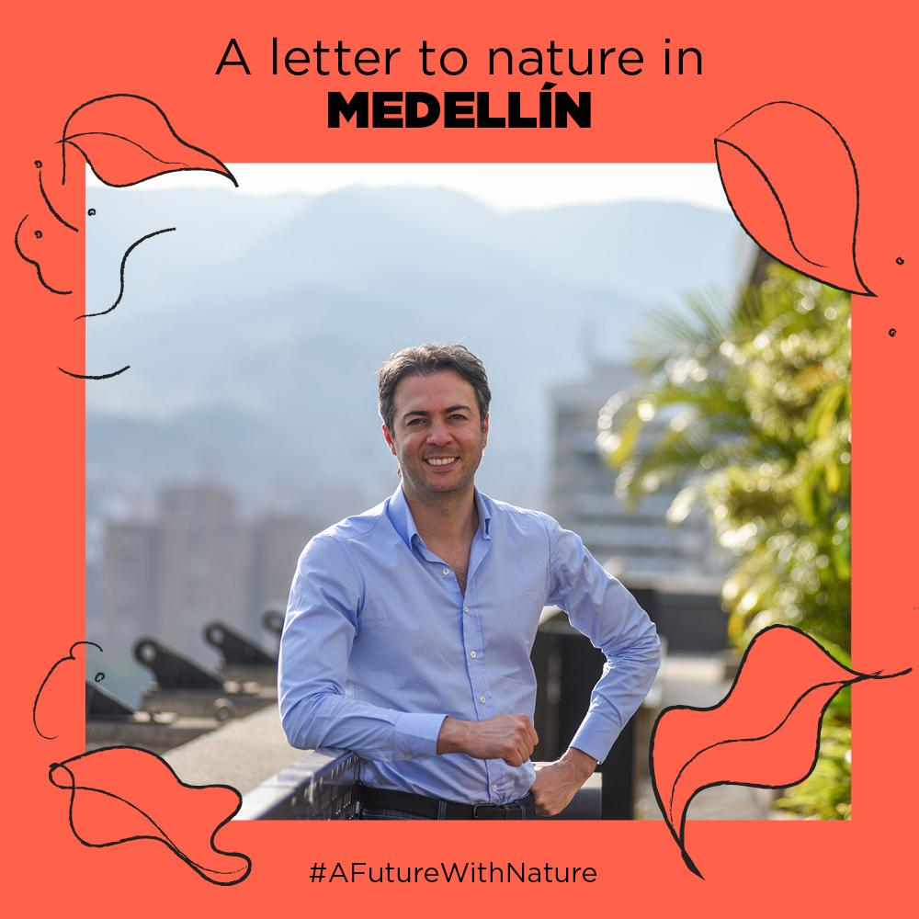
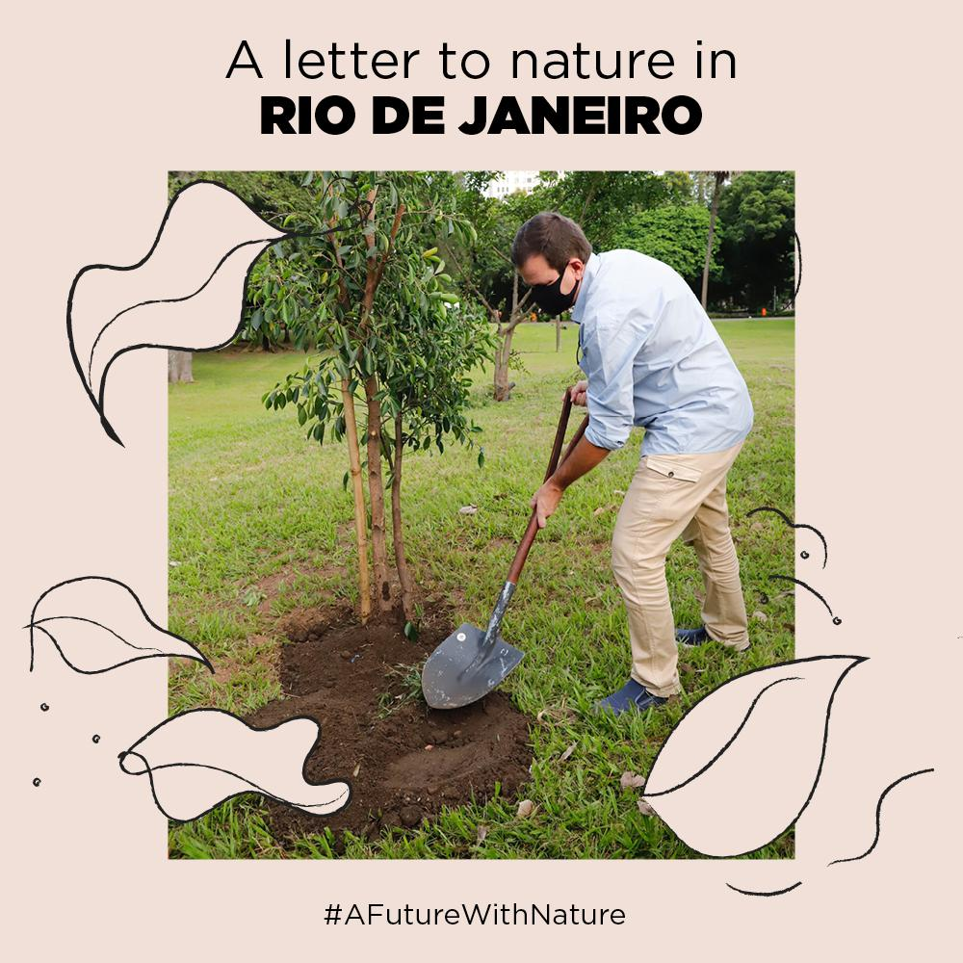
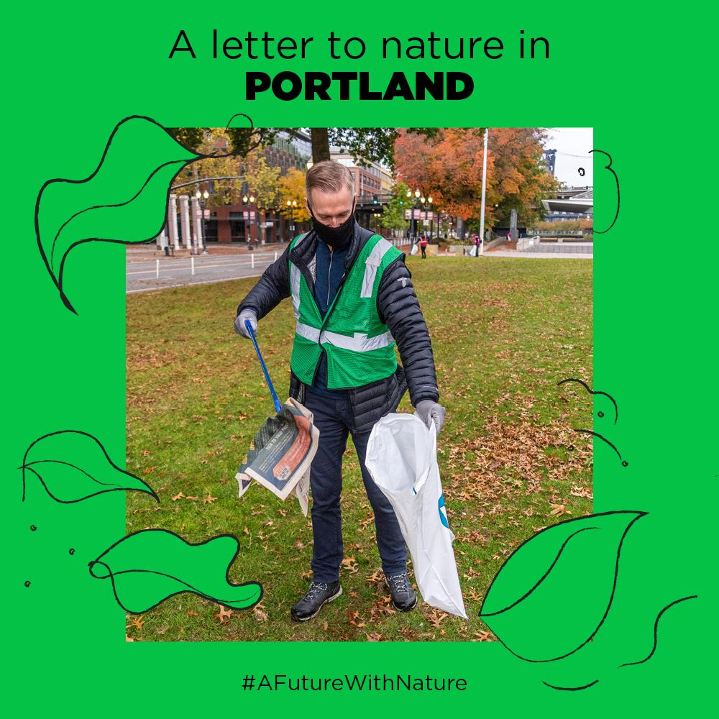
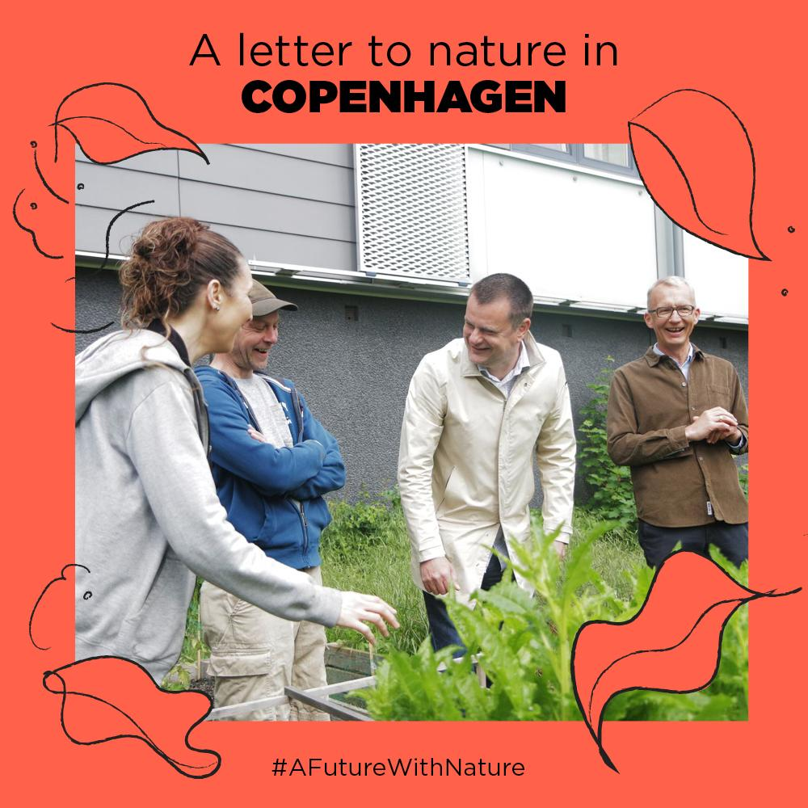
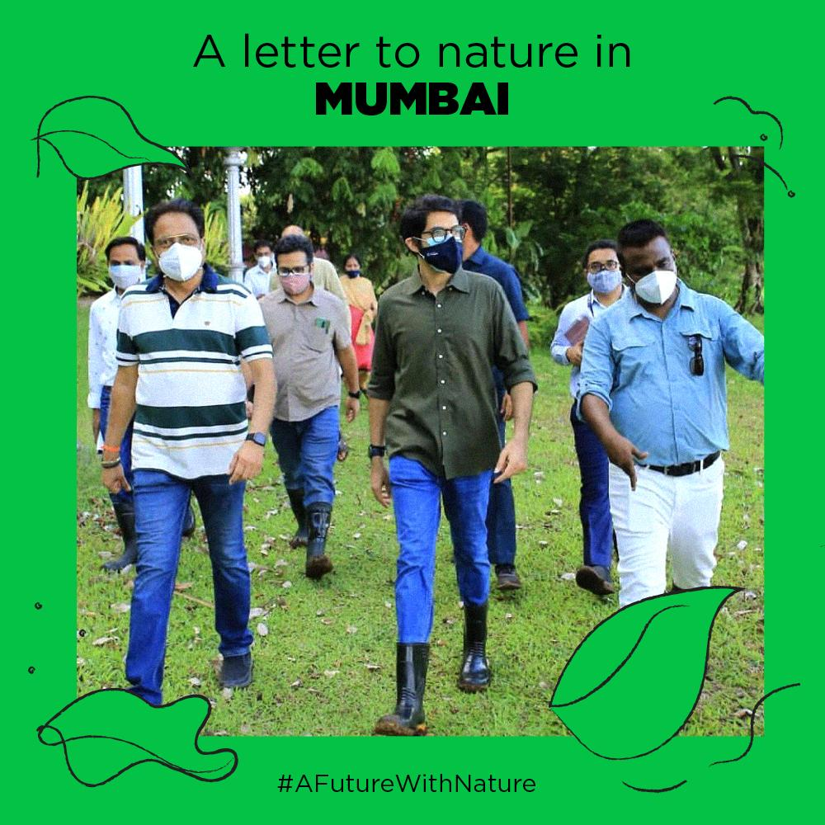
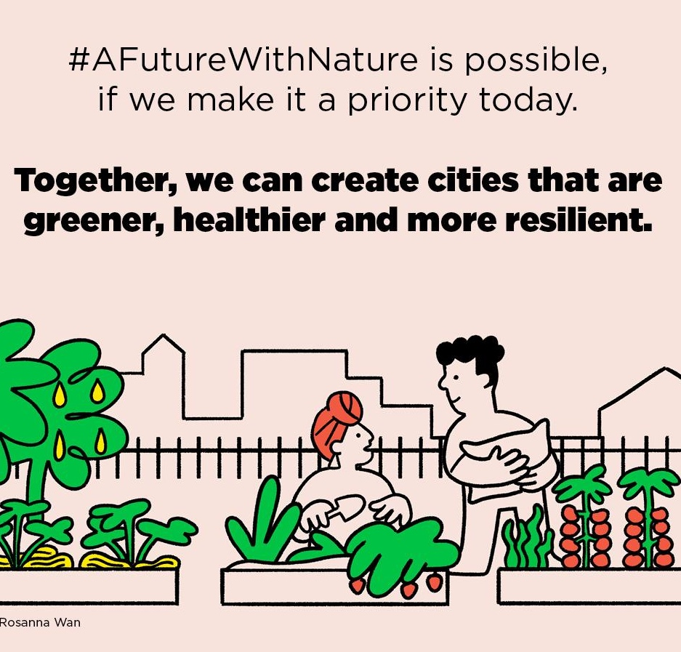
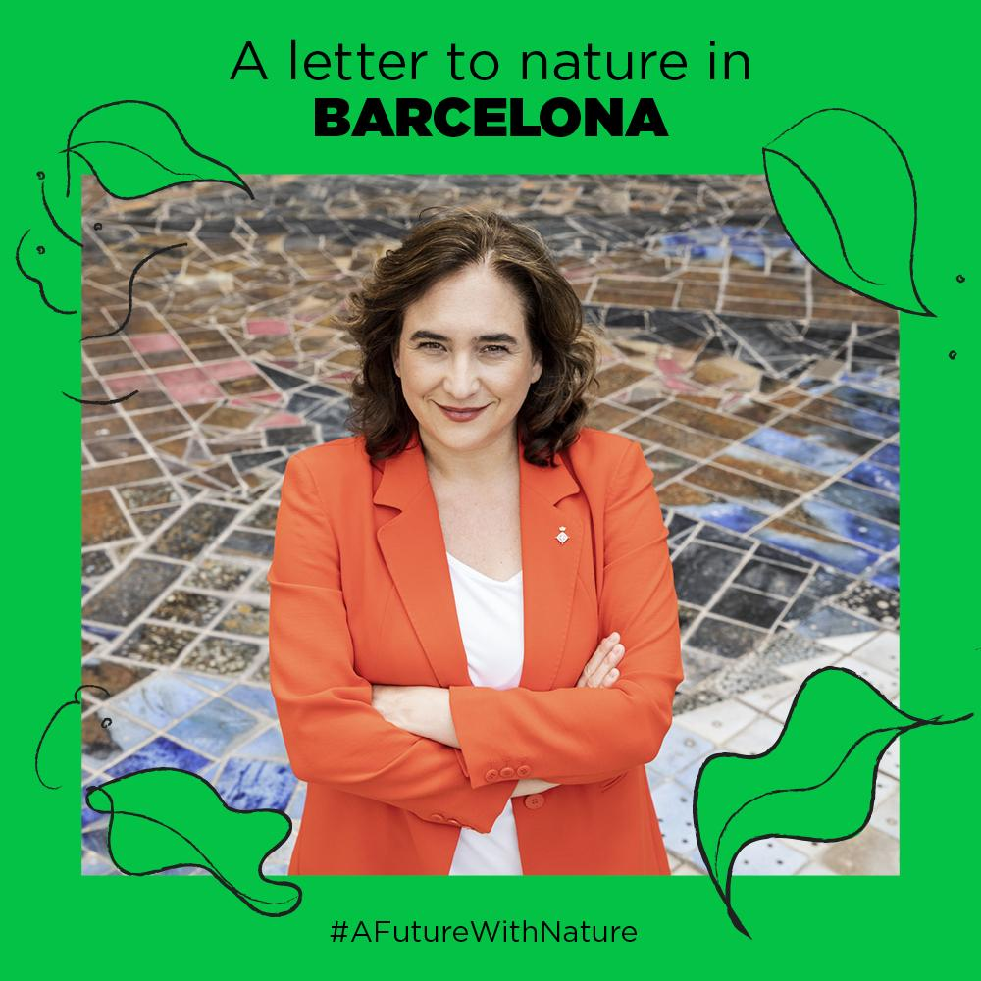
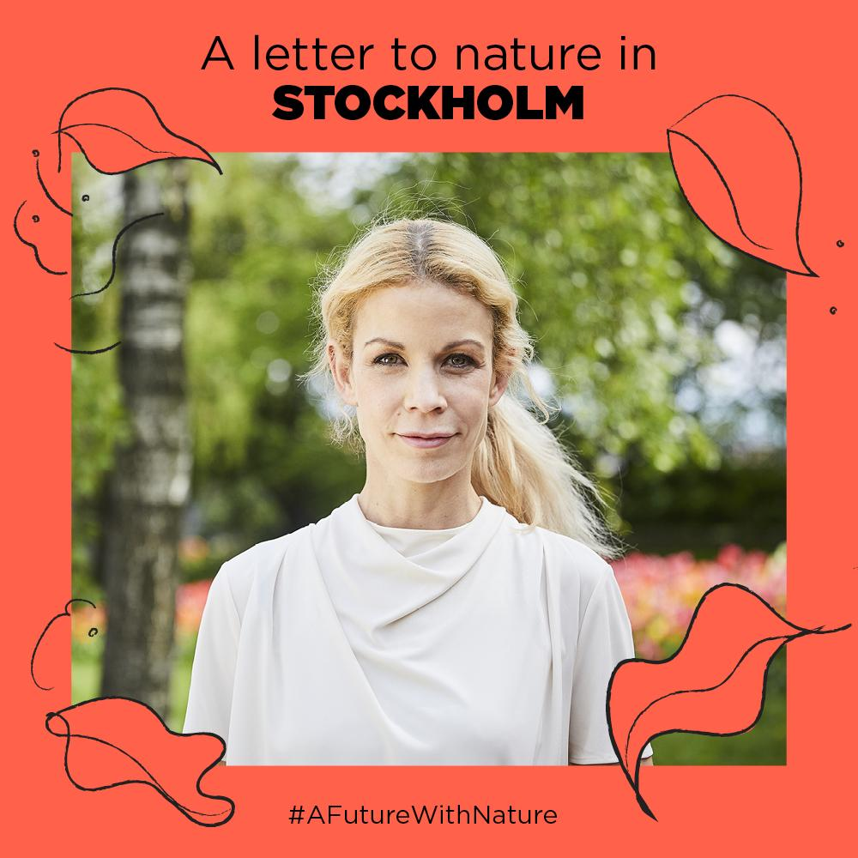
Urban Nature Declaration
Overview
Add image credit here
Notes:
Commitment made by mayors as well as technical teams
There are other initiatives that relate to urban nature (e.g. CitiesforForests, CitiesWithNature & the Leaders Pledge for Nature) which all offer:
A global network of members
Political mobilization of city voices for climate action
Some form of technical assistance
A research agenda
Support for policy design & reform
Engagement with both political and technical-level city officials
But each initiative offers distinct value:
Emphasis on different issues (e.g., biodiversity, climate, water)
Different scales (e.g., urban, peri-urban, rural)
Unique members
Different institutional backers and allies (e.g., ICLEI, TNC, WRI, Bloomberg)

Slide 10
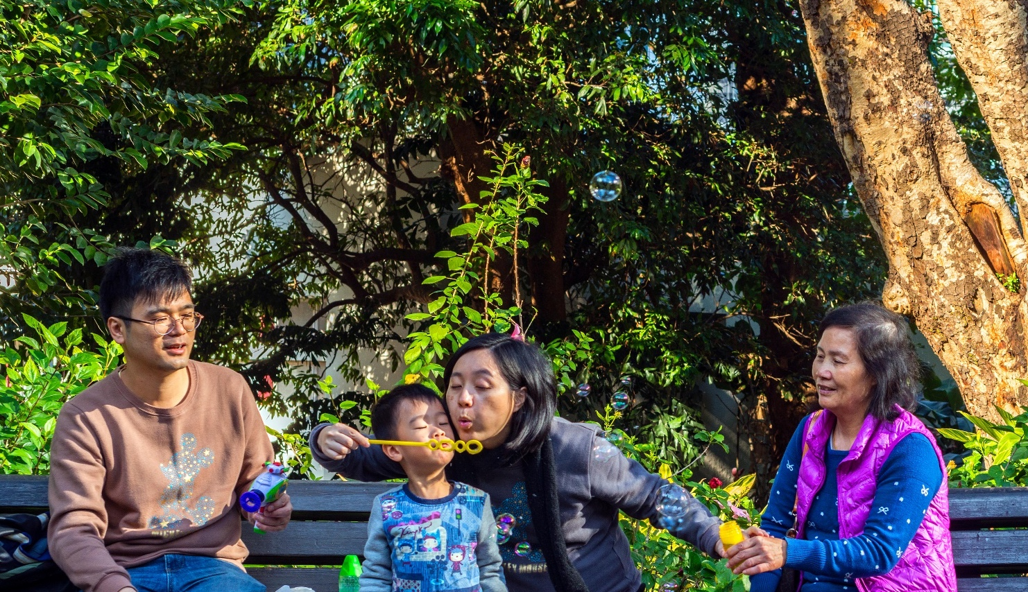
“In order to be effective, the ecological transition needs to be socially desirable”
Alexander Langer
Notes:
It goes to show that “In order to be effective, the ecological transition needs to be socially desirable”
Otherwise, if climate actions do not meet the needs of city residents, mayors will lose the permission to act. Equity and inclusion need to be built into our response to climate change from the start.

Slide 11
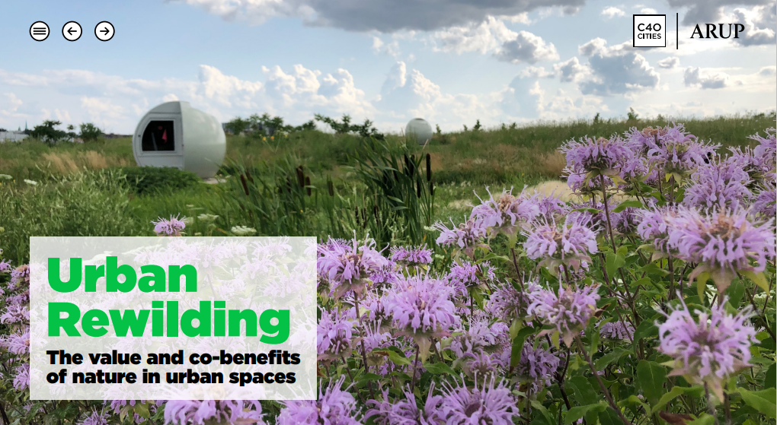
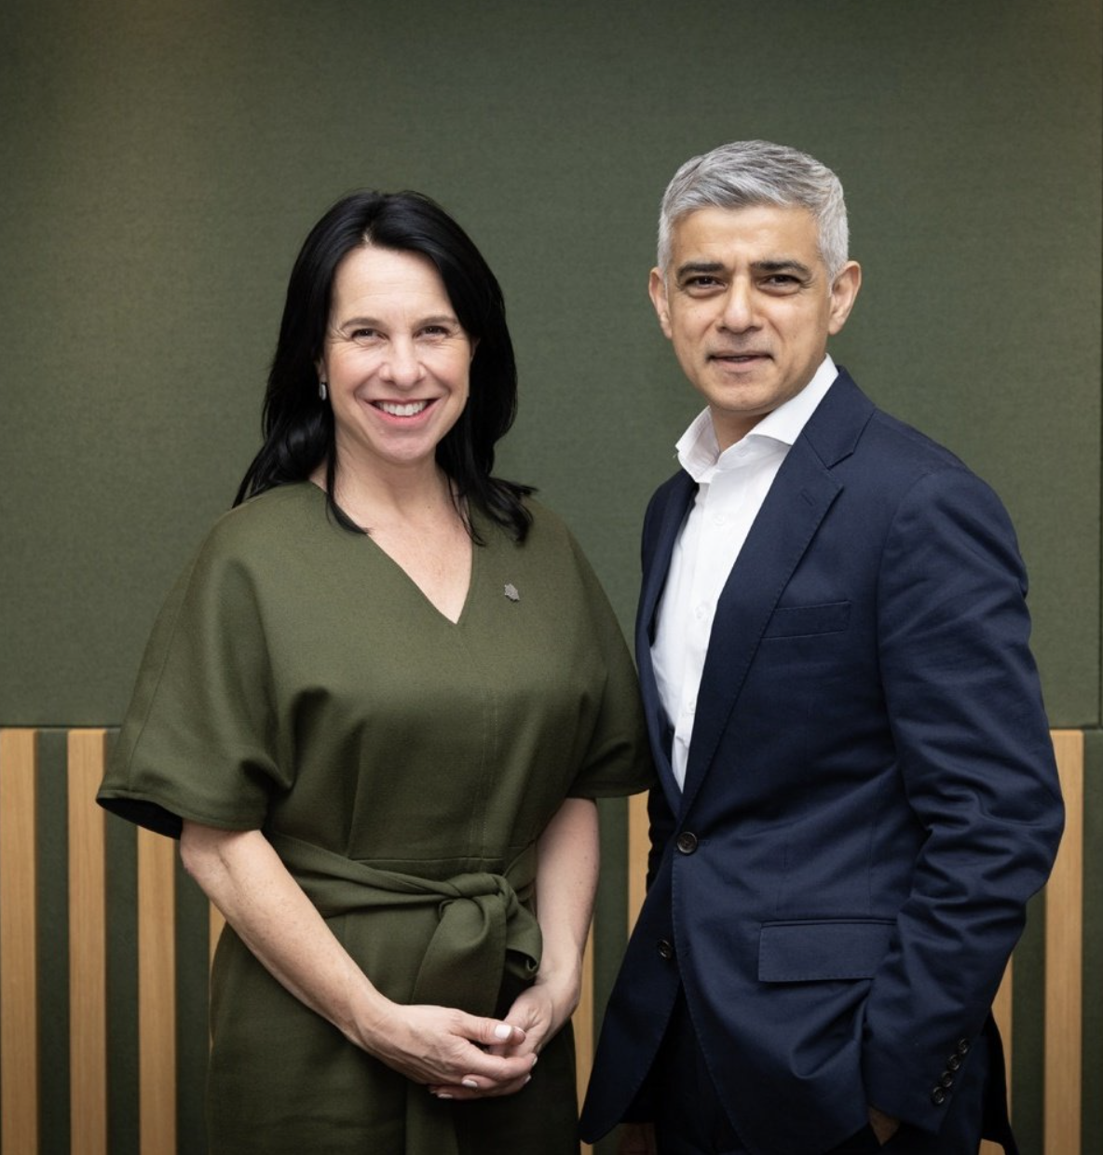
Notes:
The report was launched at a roundtable meeting on 24 April, chaired by London Mayor and C40 Chair Sadiq Khan and Montréal Mayor and C40 Vice Chair Valérie Plante. We have defined urban rewilding as ‘restoring natural habitats and their processes in urban spaces, working towards a state of human-nature coexistence’.

Slide 12
Alignment of Actors
Parks
Urban Planning
Climate
Health
C40 workshop on Green and Thriving Neighbourhoods in Santiago, Chile

Slide 13
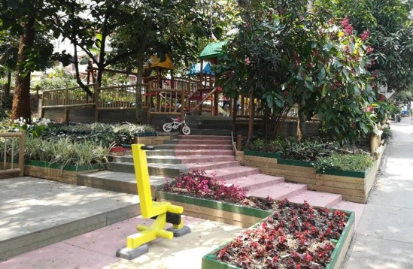
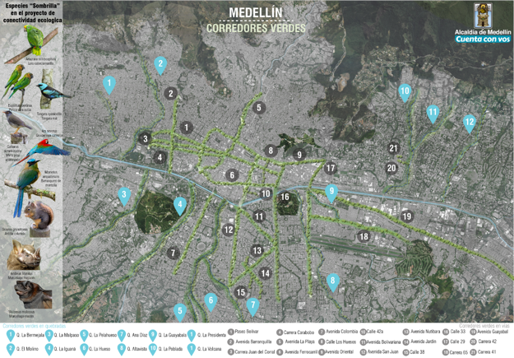
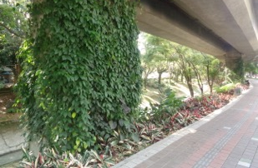
Notes:
Ecoparks through Participatory budgeting 16 neighborhoods/communes

Slide 14
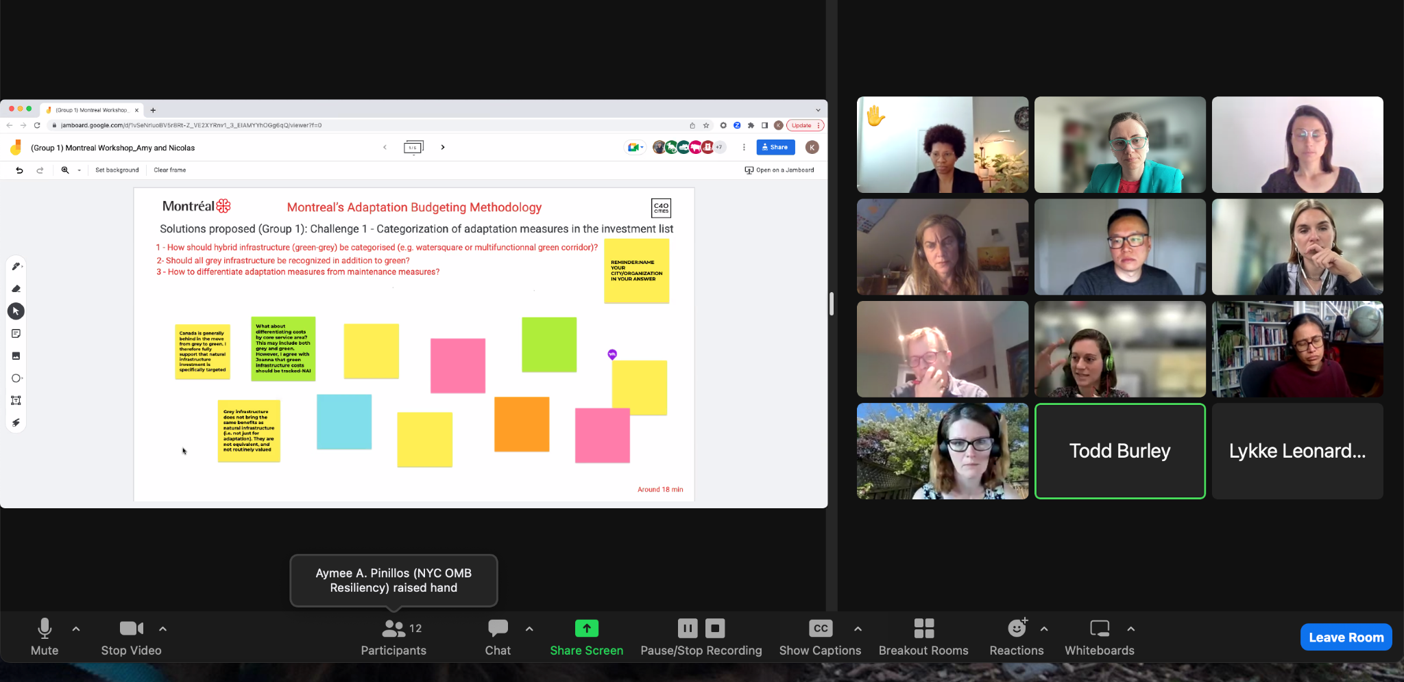

Slide 15
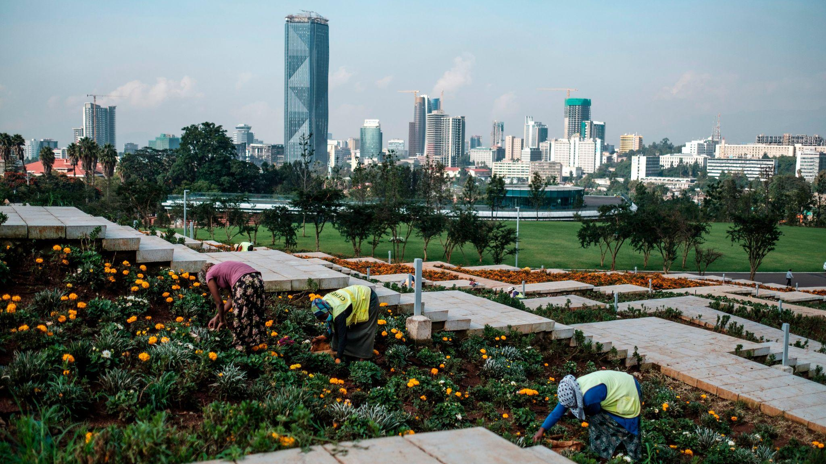
National governments must prioritise building climate resilience in cities, recognising that investing in cities is a powerful way of acting simultaneously on development, biodiversity and climate challenges.

Slide 16
Thank you
Sachin Bhoite
sbhoite@c40.org

