Slide 1
Rail as the backbone of sustainable mobility: decarbonising the transport sector
Lucie Anderton
Head of Sustainability , UIC
01

Slide 2

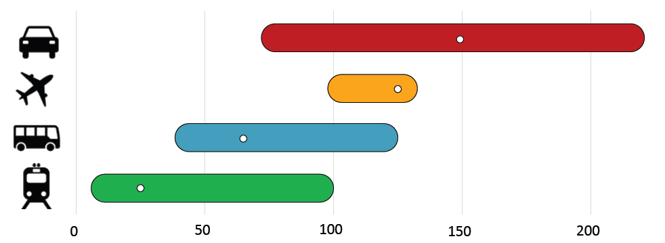
Lowest GHG intensity of all motorised modes
Global average of 22g per passenger km
With 32% global average electric tracks - On track to be the first to reach net zero
Source: IEA (2022), Rail, IEA, Paris https://www.iea.org/reports/rail, License: CC BY 4.0
Notes:
22g Co2 equivalent emissions per passenger km - global average

Slide 3
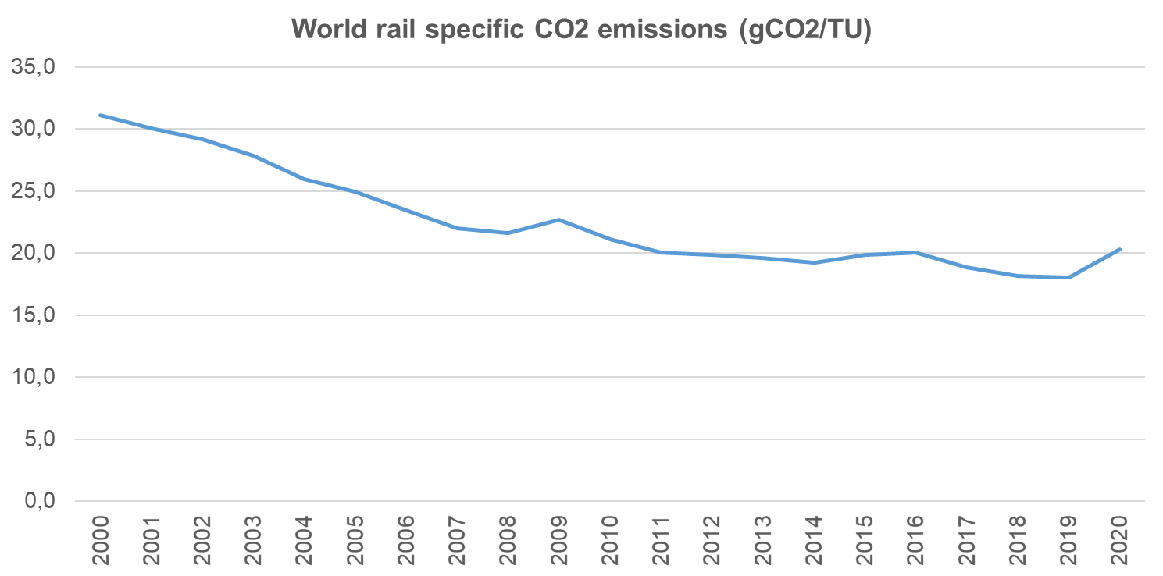
Source: UIC (2021), Energy and Traction Energy Database
The only mode to have reduced total emissions - 25% more energy efficient in the last 15 years

Slide 4
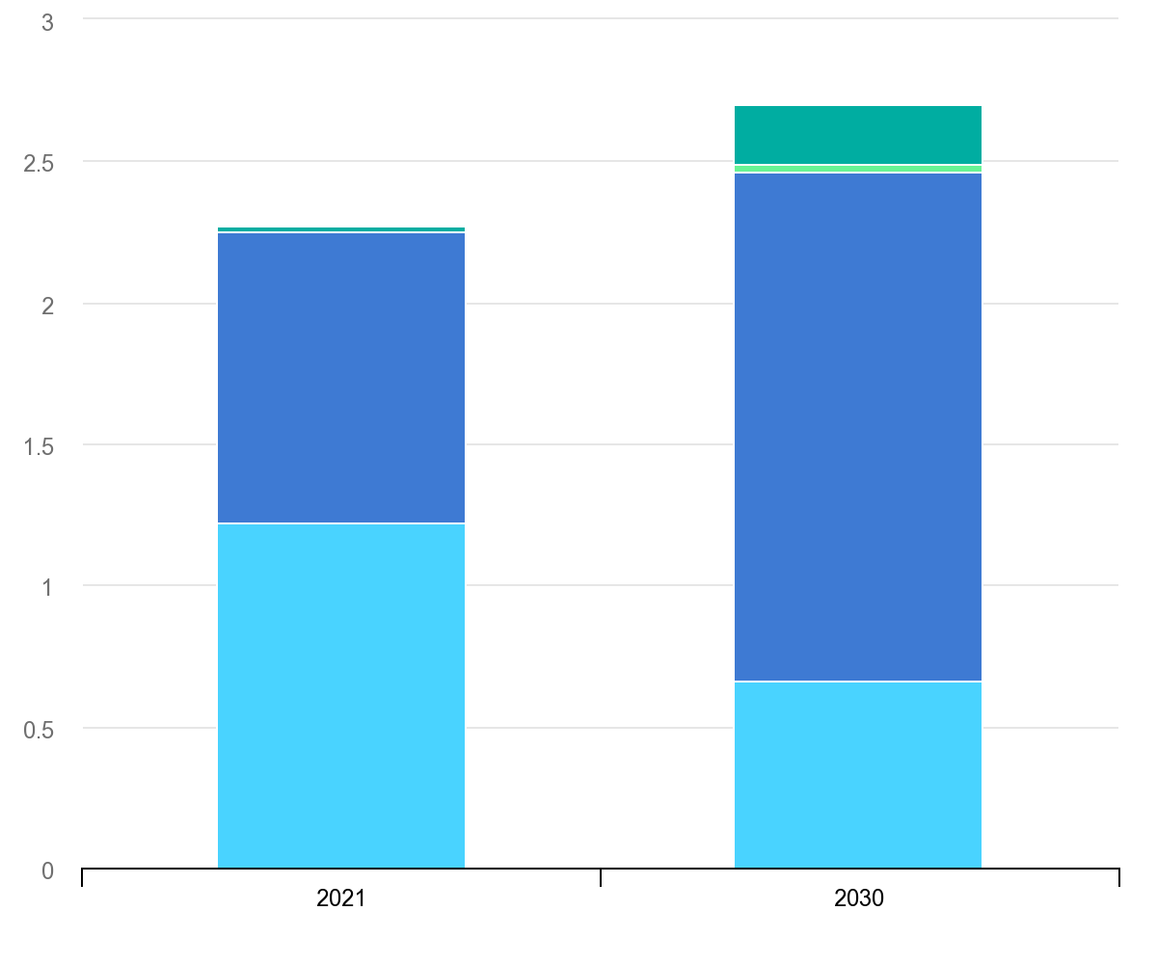

IEA Net Zero Scenario (EJ)
Through modal shift, rail electrification, new renewable power integration, digitalisation and energy efficiency, 460Mt GHG emissions will be avoided by 2050
Total energy demand must grow as rail expands with modal shift from aviation and road
Electricity demand needs to grow to 2/3 by 2030 - particularly in freight
Source: IEA (2022), Rail, IEA, Paris https://www.iea.org/reports/rail, License: CC BY 4.0 (GWH)

Slide 5
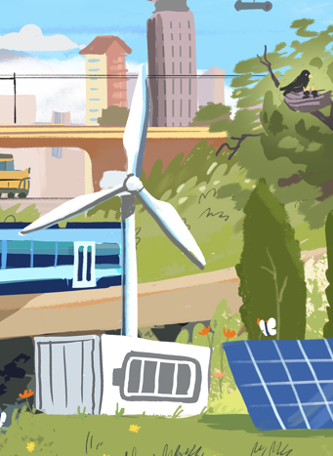

Plan investment in renewables in synergy with investment in electric railways to accelerate the transition
Renewables can be installed in neighboring land, depot and station rooftops, carparks and even on noise barriers
Electric rail networks can improve access to clean energy and balance supply with demand
The Indian Railways has drawn up a plan to install a massive 20 gigawatts of solar power capacity on its own land by the year 2030.
The Ethio-Djibouti railways – the first electric rail in east Africa was planned with the new hydro-electric dam of the Nile

Slide 6
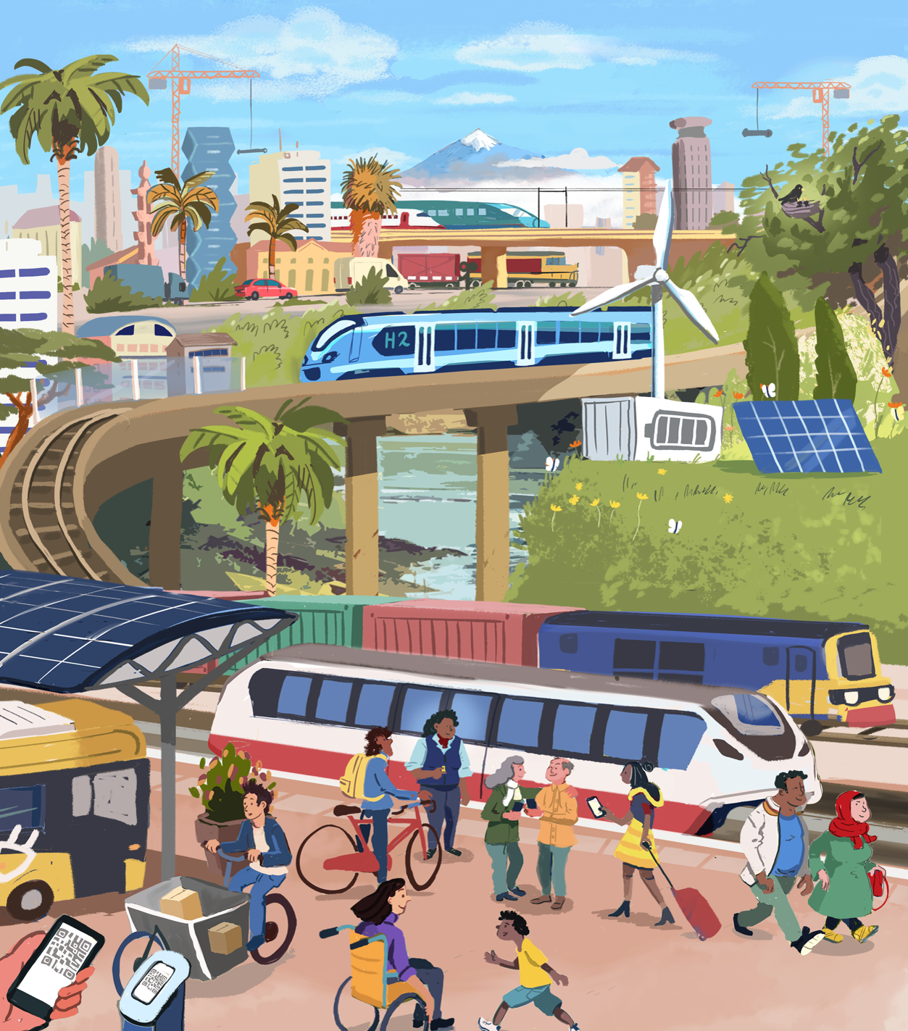
Clean Air and healthy cities
Congestion reduction and safety
Land Use
Green Job Creation
Economic Prosperity
Accessibility and social inclusion

Slide 7
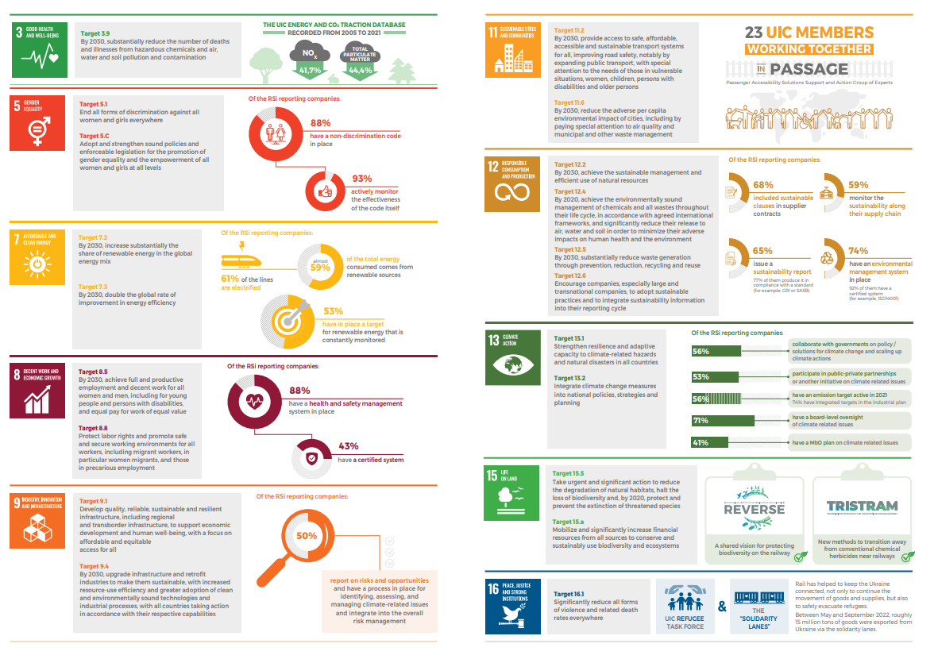

2022 Global Rail Sustainability Report (uic.org)

Slide 8
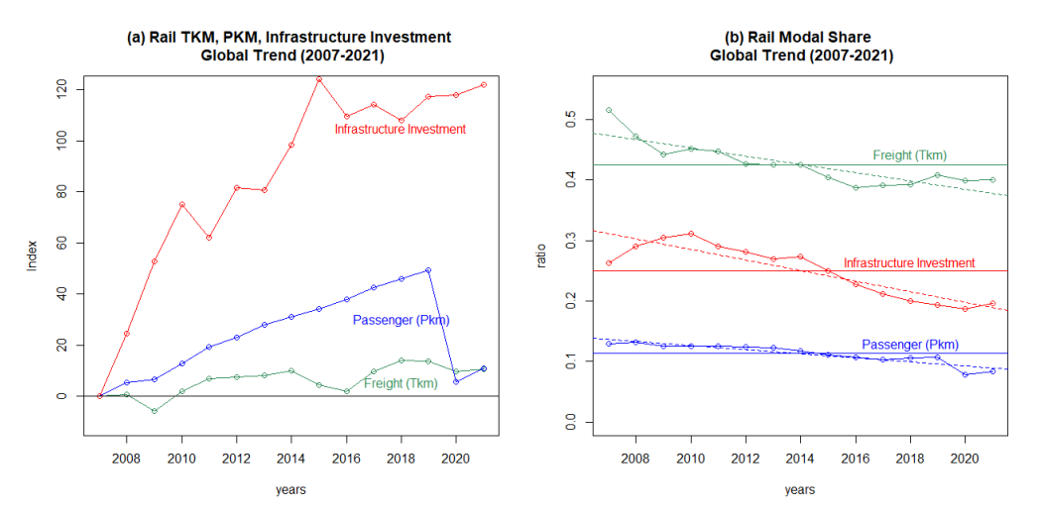
But… right now, modal share trends for rail are negative
the_modal_share_of_rail_in_inland_transport_and_infrastructure_investment.pdf (uic.org)

Slide 9








Just 25% of NDCs feature Rail
Only 10% of NDCs have targets for Rail
What makes for great NDCs to promote rail?
Have clearly defined objectives
Elevate Ambition
Adopt Comprehensive approach
Ensure Cohesive planning
Develop Measurable targets
Specify Financing and Funding Mechanisms
Notes:
NDCs can be a powerful tool for countries to unlock the full potential of the rail sector to deliver reduction of GHG emissions from the transport sector needed to achieve the Paris Agreement, whilst promoting multiple Sustainable Development Goals. In the next cycle of NDCs, countries can portray how the rail sector can contribute as a climate solution in a more effective way, if considering the following recommendations:

Slide 10

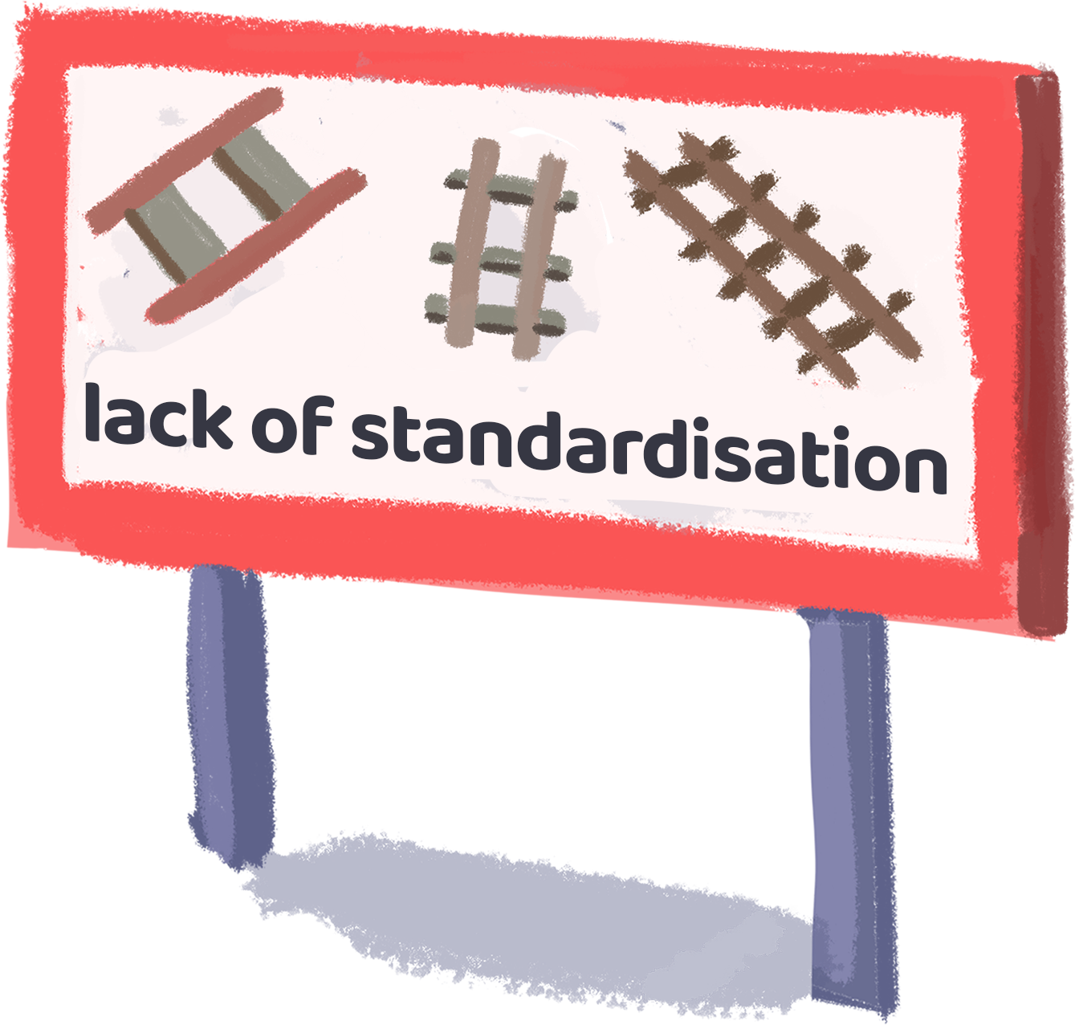
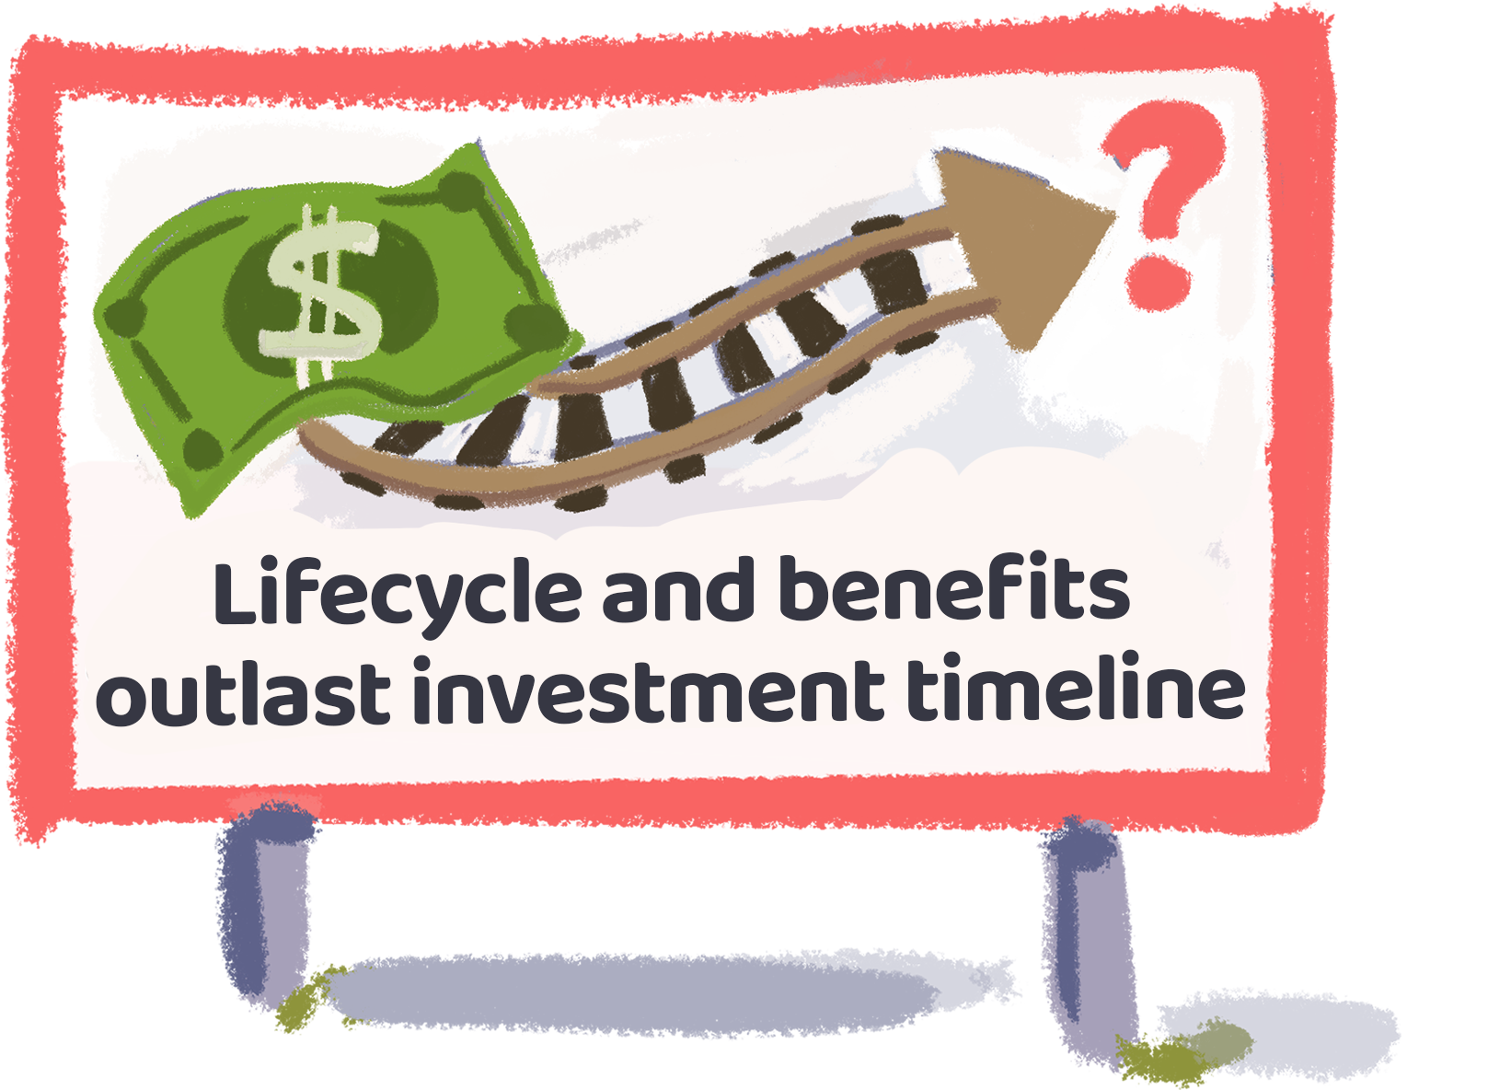
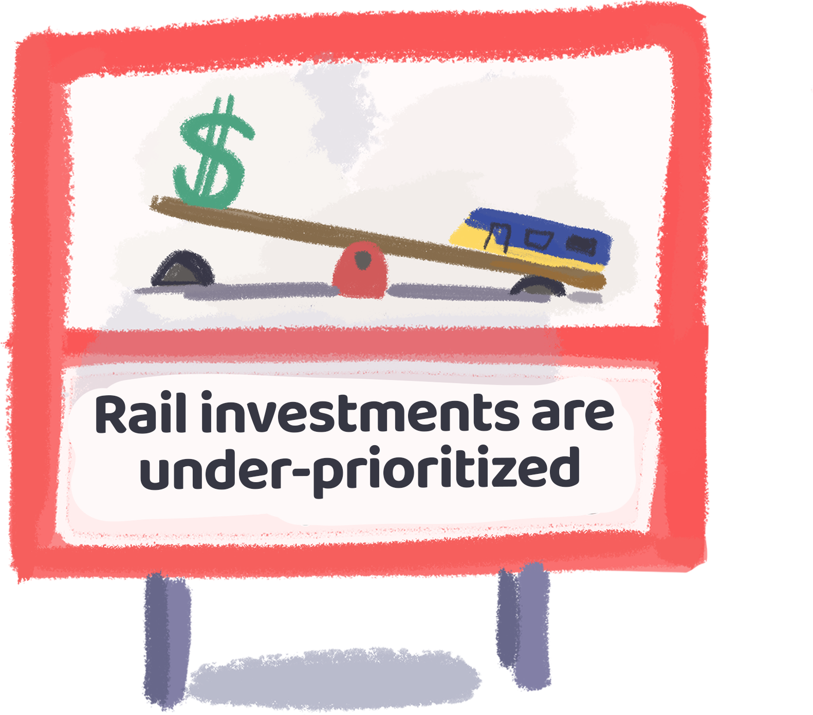
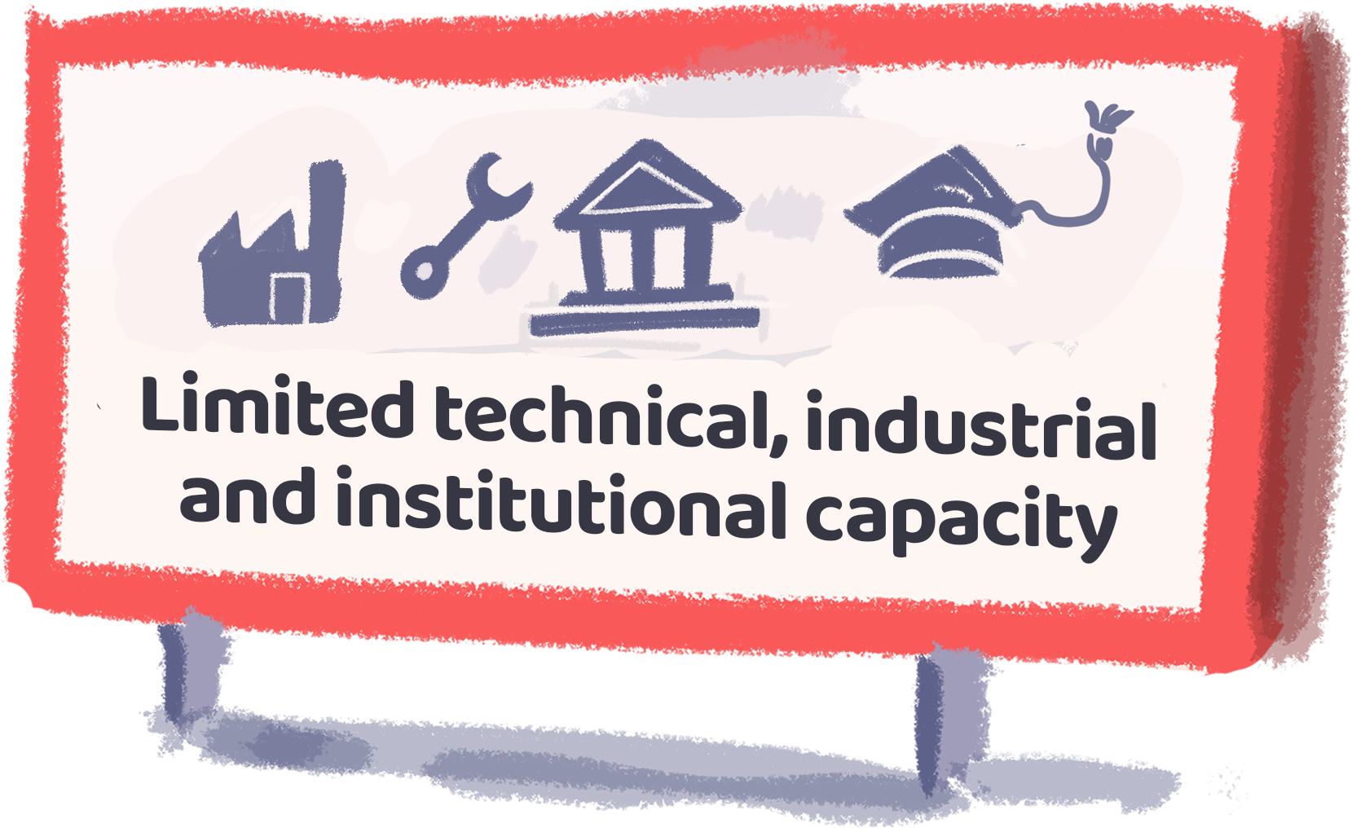
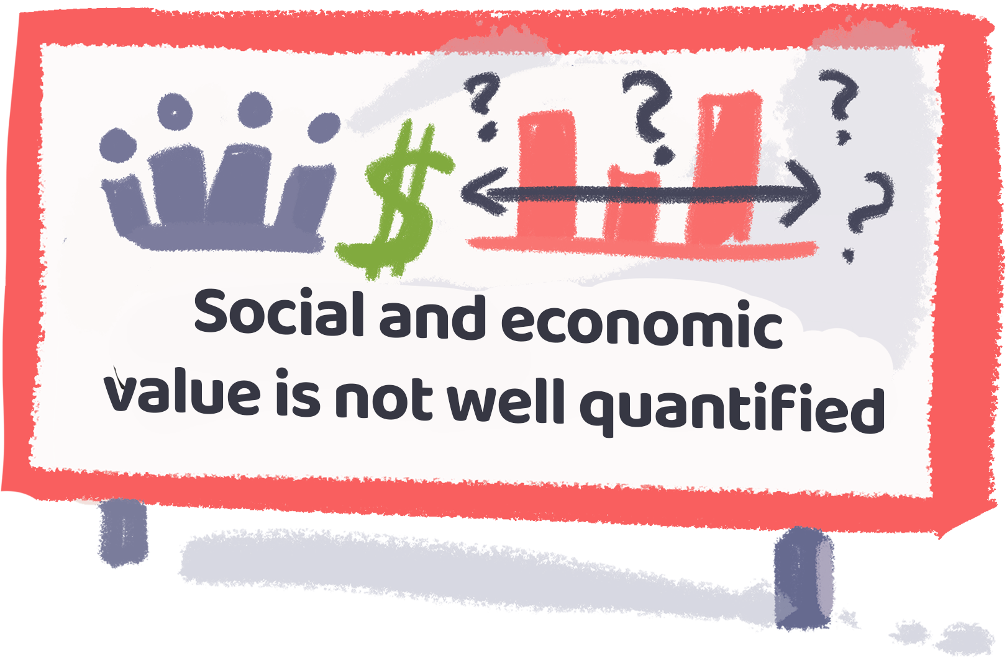
Bridging the Rail Finance Gap
Rail investment can help LICs and LMICs achieve climate goals by quadrupling rail modal share
In Low and Low-Middle Income Countries
If transport emissions in LICs and LMICs grow at the same rate as HICs, global emissions could increase by 16%.
LICs and LMICs currently have 10x less rail infrastructure than HICs, with an average network density of 4.95 km per 1,000 km
What are the barriers for more rail finance?
Notes:
=

Slide 11








Recommendations
1
2
3
4
High income countries should provide grants to fund rail projects in LICs and LMICs
Allow rail projects to be funded under Article 6 and support the development of carbon finance market regulations for rail
IFIs should adapt methods of cost-benefit analysis of rail projects and greatly increase funding to rail
LICs and LMICs should lead implementation of policies to spur private investment in rail, and modal shift
5
6
7
International finance sector should make financing rail more attractive to public & private sectors and build capacity in LICs and LMICs
LICs and LMICs should collaborate with rail industry to structure projects to maximise broader economic benefits
Rail industry should leverage digitalisation and advances in rail technologies to improve attractiveness
Notes:
=

Slide 12


