Slide 1

UNFCCC COP28 – Dubai, UAE
18th Global Forum on Human Settlements 2023
Early Warnings for All: Building urban
Heat wave early warning system.
Dr Ousmane NDIAYE
Ousmane.ndiaye@anacim.sn
Agence Nationale de l’Aviation Civile et de la Météorologie (ANACIM)
3 December 2023,13:30-15:00, Radisson Blu Hotel, Dubai Canal View

Slide 2
Cities and climate changes
Some Climate change signals :
Global temperature keeps rising
Sea level is rising
Extreme events more frequent and more intense : flooding, heatwaves, cyclone, bushfire, etc …
Cities :
Most of world population lives in cities : African cities are vulnerable to CC and natural disasters due to population densities (most of big cities are on sea-border)
Rural exodus is increasing due to CC : housing pressure on natural resources, transportation + urbanization drive more pollution, lack of proper sewage system, urban planning lack behind population growth/demand (suburbs), etc
Most of emission comes from city’s activities : Cities occupy just 3% of the Earth’s land, but account for most of the global energy consumption and carbon emissions (and interconnected infrastructure )

Slide 3
Extreme events : Dust storms
(city pressure on land for housing and farming)
Socio-economic impacts :
Health : meningitis disease as well pollution (on top of fossil pollution)
Decrease in carbon capturing (cut down trees for fire woods and habitat)
Poor soil fertility for cultivation this more land needed for cultivation
Land degraded for housing

Slide 4
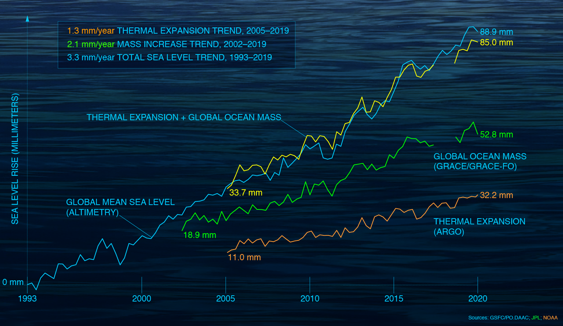
Extreme events : Sea level rise (SLR)
(27 years of satellite altimetry observation)
Global SLR has increased from 1993 to 2019 by 3.3 mm/an. (NASA)
time series from GRACE/GRACE-FO and Argo to the GMSL time series from satellite altimeters (Credit: NASA.)

Slide 5
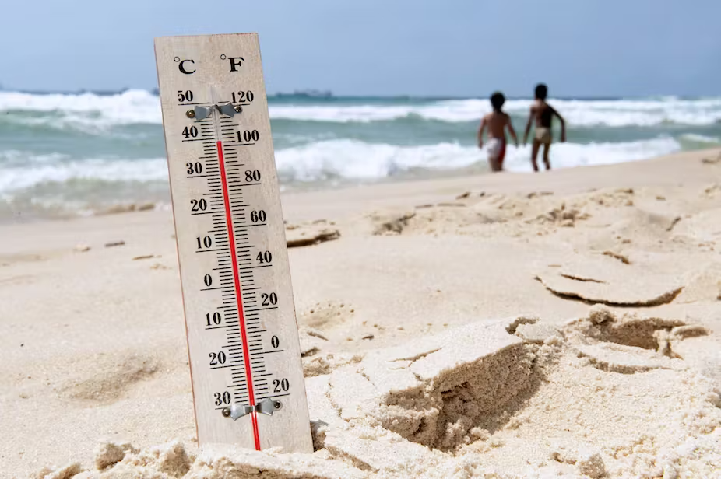
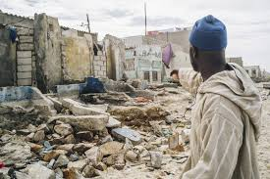
Extreme events : Sea level rise and coastal cities
Sea levels rise increases vulnerability in low-lying coastal areas :
Climate risks :
storms and high tides
coastal flooding and erosion
Salt intrusion
Impacts :
Economies : beaches, hotel infrastructures, materials resistance (salt), …
Social : human populations displacement (10% of the world's population live in coastal areas) and threat coastal ecosystems and habitats.

Slide 6
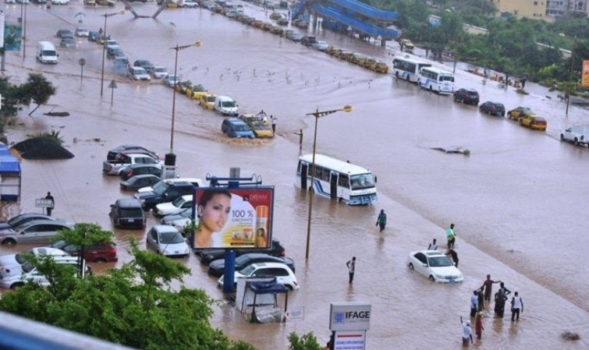
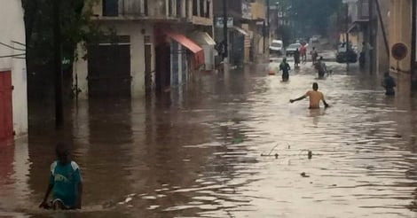

Extreme events : Flooding
Climate changes is increasing extreme rainfall events :
African cities are more and more prone to rainfall extreme events leading to floodings
Impacts :
Health : water related disease, malaria for more killing disease (233 million cases of malaria reported in the WHO African Region in 2022, compared to 234 million cases in 2021, WHO)
Transportation : disturbed, cut off,
Social : usually poor people lives in degrading area (suburbs) and increase their poverty (no one left behind), usually with thunder (death),
Economy : power shortage,
Notes:
https://www.afro.who.int/health-topics/malaria

Slide 7
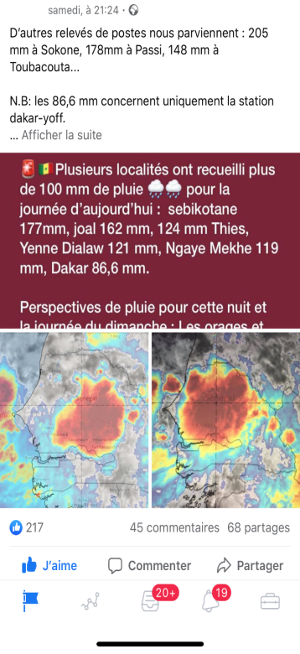
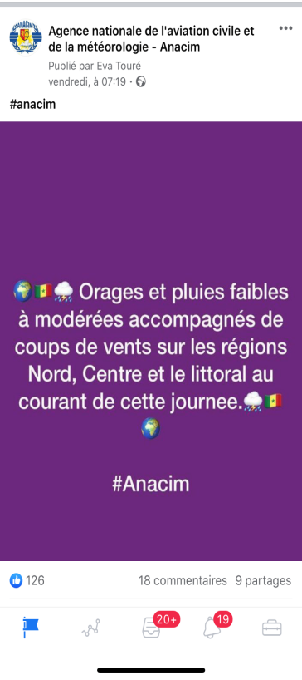

Extreme events : early warning city Flooding
Flood EWS :
Climate information dissemination during a flooding events forecast (hours to 2/3 days before the event) through social media (text and voice messaging, Facebook, twitter, emails, etc.) and public-private partnership.
Meteo service (ANACIM) Facebook/tweeter pages

Slide 8
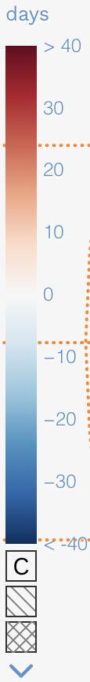
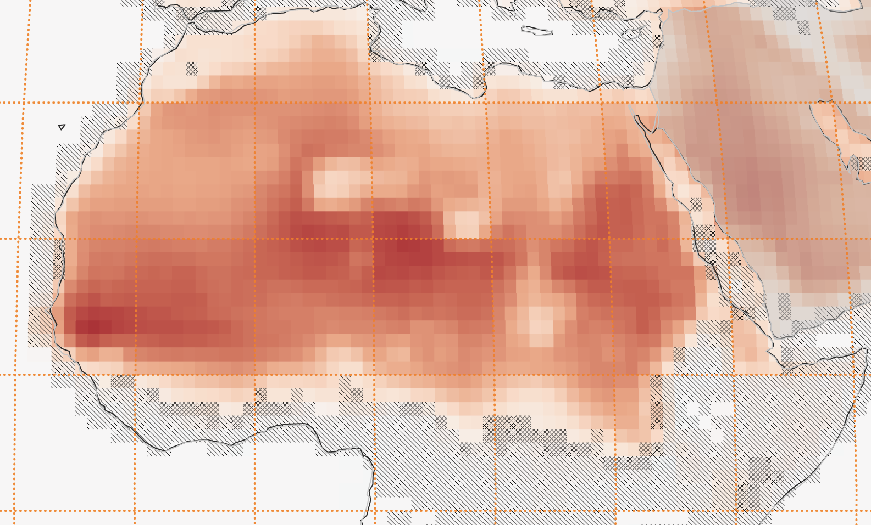
Number of hot days (Temp > 40°C) in 1.5°C world
for climate scenario SSP5-8.5 (27 MODELS)

Slide 9
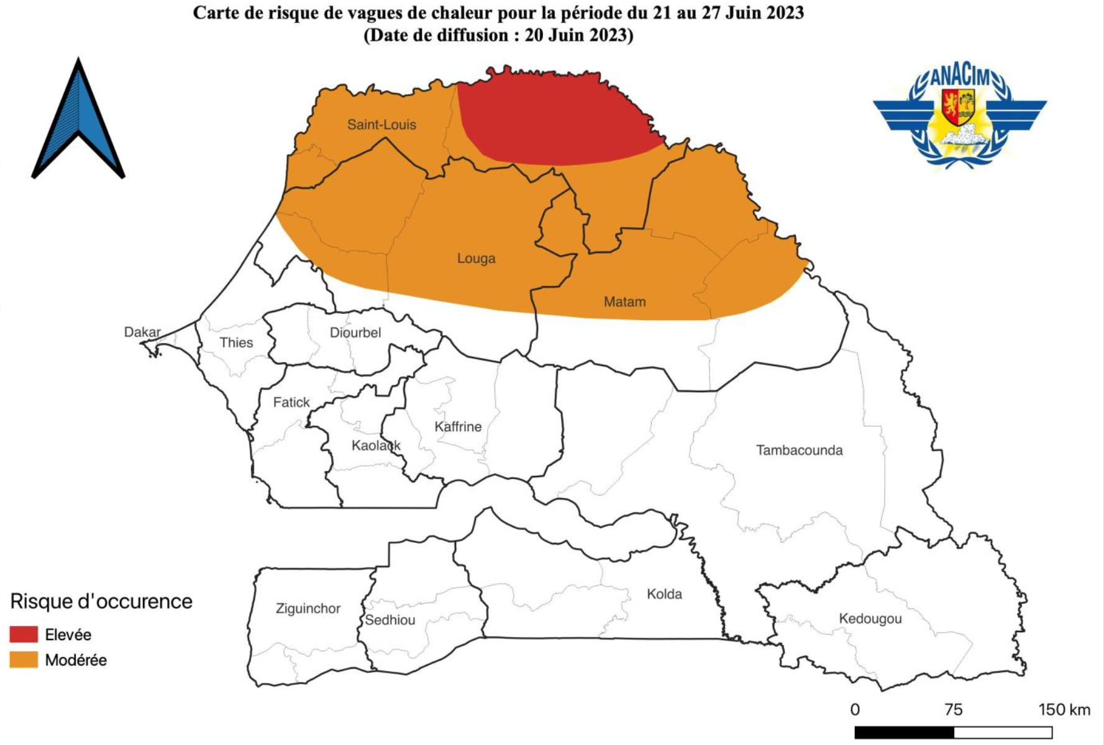





HEAT WAVE EARLY WARNING SYSTEM
Use of climate information for an early warning early action to reduce heat waves impacts
City Vulnerability mapping :
Identify within the cities vulnerability indices (combination of) :
Access to health facilities
Access to air conditioning/ventilation
Access to drinkable water
Access to natural cooling (beach, swim pool, etc )
Access to electricity
Old people, pregnant woman, children,
People with HW prone disease
Dense populated area, School locations,
Categorize different zones of vulnerability
Climate Forecast 1 to 3 weeks ahead
Heat wave detection (threshold)
Vulnerabilities mapping on heat waves

Slide 10
Heat wave early warning bulletin
Heat waves forecast
Advices to population
Impacts maps

Slide 11

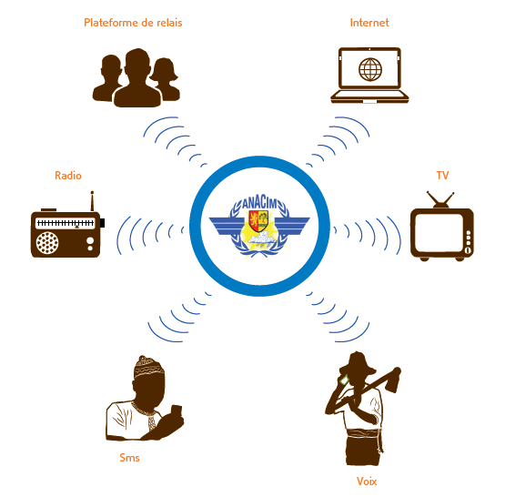

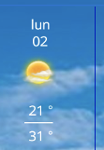
Disseminating Channels Of Climate Information
END USERS ORGANISATION
CLPA
ORGANISATIONS PAYSANNES
GTP
FAO (appli mobile)
Naatal Mbay
DPM/DPSP – HASSMAR
DPC
Comités de Veille (St-Louis et Mbour)
FLAGS :
Beaches
Ports
ONLINE :
Site web ANACIM: www.anacim.sn
Application Mobile: Rechercher ANACIM
Sur Google Play Store
Portail web du Cadre National des Services Climatiques
Email
Community Radios
Radios nationales
Emissions
URAC
REJAQUES
PRESSE ECRITE
TV Bulletin
Participation aux émissions TV
Infos Météo dans les émissions TV Yeewoulen(TFM), Sen Show(SEN TV), Kinkeliba (RTS) et RDV
TELEPHONE (text msg)
Alertes SMS et VOCALES: pêcheurs (CLPA), organisations paysannes, CNGI, services techniques (pêche, croix rouge, Enda NRJ, FAO, Ministères…)
TELEPHONE (voice messaging)
Phone App
Accessing Alerts
Notes:
No differents cannaux de diffusion de l’information climatique : ilfaut s’arreter un peu ici

Slide 12
QUELQUES MESSAGES CLES DU 6EME RAPPORT DU GIEC
Smart climate management (planning) by using climate information : long term planning (CC), seasonal, weather (daily), nowcasting (hours)
Include climate information in all plannings (long and short term) : construction (sizing), city traffic (peak of pollution), early warning extreme climate events, etc …
Actionable Early warning system for all to anticipate climate shocks
building climate-ready cities (Urban planning ) : house construction materials, housings ventilation and natural lightning (day light saving), sewerage network sizing, green area reserves, …
Climate change is happening now and we need to attenuate but also to adapt our cities through climate smart planning.

