Slide 1
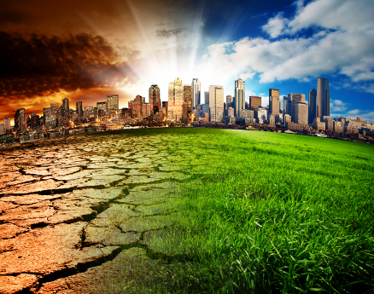
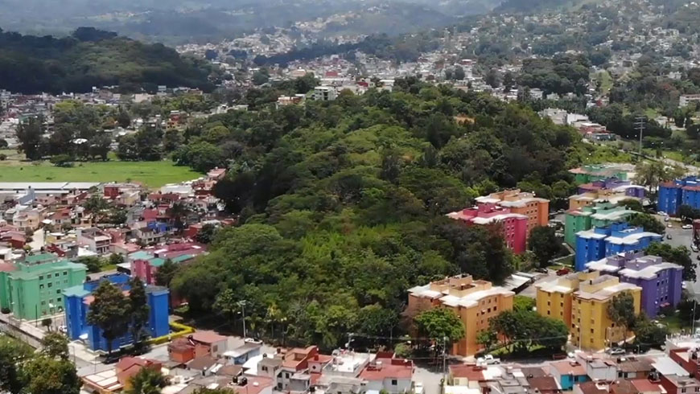
Nature-based Solutions and zero carbon resilient cities
Global Forum on Human Settlements
Thematic Session 3B: Local pathways to net zero emissions and a resilient future
Chantal van Ham, Acting Director, IUCN European Regional Office
28 October 2021
GEF
Notes:
Local governments are faced with significant challenges. Many of the services they provide - including water and wastewater delivery, waste removal, transportation, and environmental services - depend on engineered infrastructure assets that are in need of renewal. Meanwhile, the effects of climate change are expected to put even more strain on these assets and on local government budgets going forward.
But there is one class of assets that local governments are under-accounting for: natural assets. Natural assets are ecosystem features that are nature-based and providing services that would otherwise require the costly equivalent of engineered infrastructure.
For local governments, natural assets can include forests which convey stormwater and recharge aquifers, wetlands which reduce flooding risk, and coastal areas which protect against storm surges and sea level rise, among others.
IUCN can provide expertise based on in-depth knowledge of local environmental conditions, as well as state of the art solutions provided by nature to help to tackle the world’s major challenges related to climate change, biodiversity loss, food and water scarcity, health and wellbeing. In addition, we support the establishment of new partnerships that help mobilise investment for the upscaling of nature-based solutions. The following slides give some examples of the work of IUCN Members and partners.

Slide 2
IUCN, a unique democratic union since 1948...
Members
Commissions
Secretariat
+900 full time staff worldwide
HQ in Gland, Switzerland
Over 50 offices around the world
1400+ members worldwide from over 160 countries
States, Government agencies, NGO
Over 60 regional and national committees
18000+ voluntary experts in 6 thematic groups:
INTERNATIONAL UNION FOR CONSERVATION OF NATURE

Slide 3
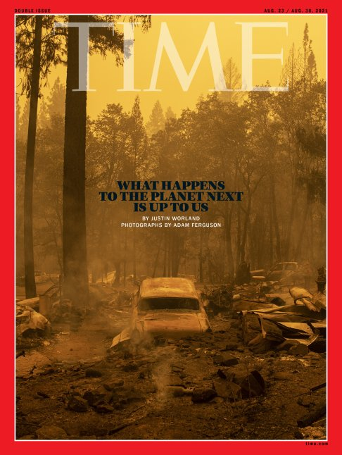
What cities can do to restore the planet for nature, people & building back the economy better

Slide 4
Philadelphia – green city, clean waters
Philadelphia has integrated nature into city planning to tackle storm water run off – green instead of grey infrastructure - transforming 10,000 acres of impervious cover to green space
Potential reduction of storm water and sewage pollution of 85%
Storm water fee: % of impervious land on private property
A green acre can soak up and filter more than 100 000 liters of storm water
18 000 trees were sponsored for planting in private residencies

Slide 5
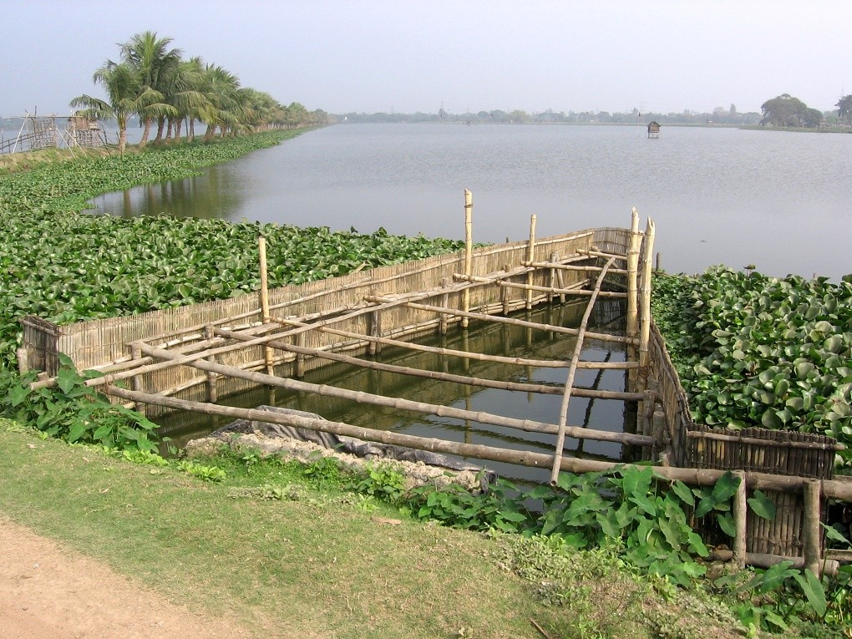
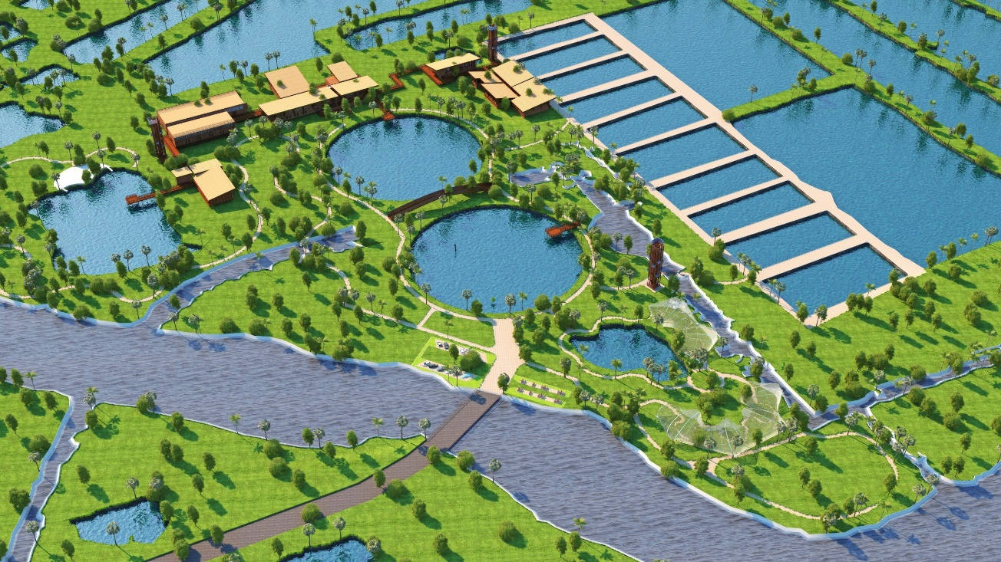
The world’s largest organic sewage management system - Calcutta
750 million litres of wastewater and sewage every day
The waterways clean the city’s wastewater in less than 20 days. This purified nutrient-rich water is then channelled into ponds, where algae and fish thrive
These wetlands act as a natural flood control system for the city

Slide 6
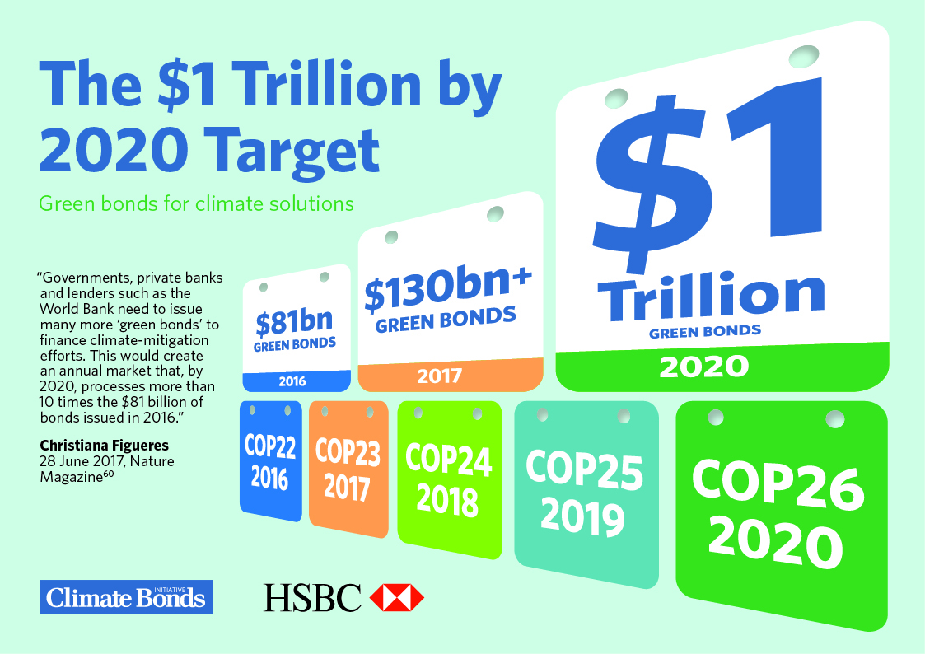
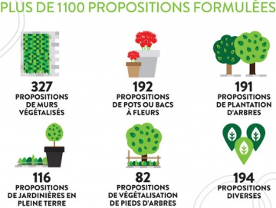
City of Paris Climate Bond
€ 300 million for climate and energy projects until May 2031, aimed at private investors
As part of climate adaption efforts: planting 20,000 trees (€ 18 mln) and creating 30 hectares of parks (€ 67 mln)

Slide 7
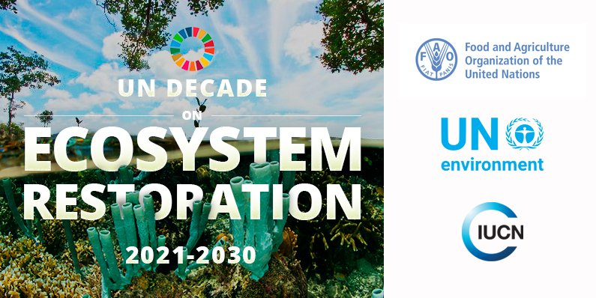
Thank you and looking forward to work together
Chantal.vanham@iucn.org

