Slide 1
Meeting the dual challenges of Covid-19 and climate change Nils Larsson iiSBE, the International Initiative for a Sustainable Built Environment October 2020

Slide 2
Introduction
The Covid-19 Pandemic
Climate Action
Integrated Actions
Conclusions

Slide 3
Introduction
All countries around the world are now facing two major crises: the impacts of climate change and the effects of the Covid-19 pandemic
Climate change is recognized in most countries as a phenomenon that is creating disaster on many fronts.
The Covid-19 pandemic has been a global health, social and economic disaster. A vaccination program is not likely to be widely implemented until late 2021, and other novel viruses are also likely to emerge.

Slide 4
Introduction
Global economies have already been badly damaged by the pandemic, and a rebuilding program is seen by international institutions as requiring major investments.
The massive costs of mitigation of and adaptation to climate change are becoming apparent and will rapidly mount.
The need to address both crises offers great opportunities to integrate post-pandemic goals with those of climate action, and the next 3 to 5 years are our last chance to take strong action to deal with climate change.

Slide 5
The Covid-19 Pandemic

Slide 6
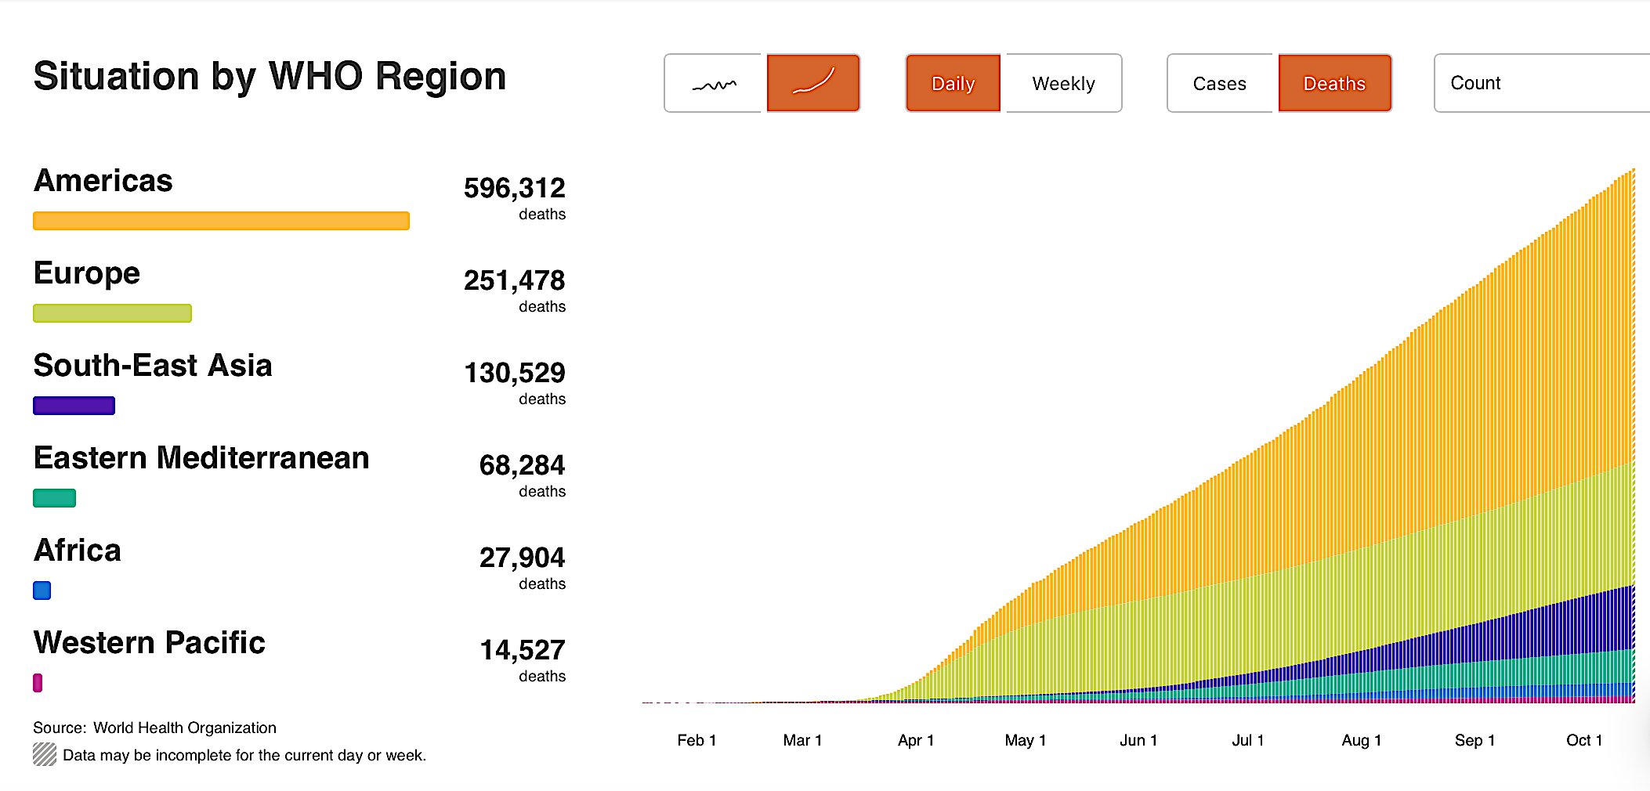
The Situation
Covid-19 Deaths
15 October 2020
https://covid19.who.int/?gclid=EAIaIQobChMIt8LUuZOn6gIVlY3ICh3V5QnrEAAYASAAEgKR-fD_BwE

Slide 7
The Covid-19 Pandemic
The Covid-19 pandemic has revealed important conflicts between pandemic health requirements and the ability to satisfy these in urban areas or buildings of various occupancy types.
Some requirements can be met with changes in building management or with minor renovations, but others demand more substantial changes which may not be easy to implement in the short term.
Other issues are related to the urban scale, and there are even larger questions of national governments taking up the task of post-pandemic reconstruction.

Slide 8
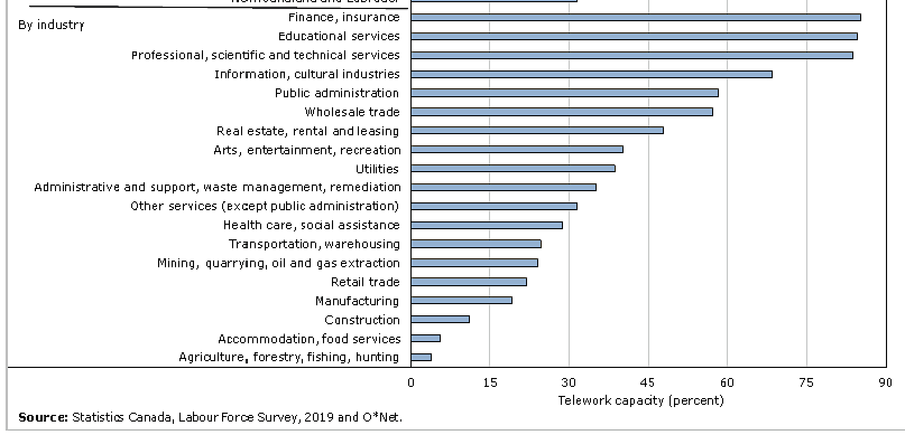
Covid-19 actions needed – policies and programs
Adapt to massive changes in work and formal education patterns that are causing an outflow of population to suburban and exurban areas.
Shifting work patterns: telework capacity by industrial sector, Canada 2019
Workers in some sectors have little or no access to telework.

Slide 9
Covid-19 actions needed - policies and programs
Make use of urban areas and buildings made redundant by the pandemic:
a. Convert unused open parking spaces to parks, trees and open-air recreation facilities.
b. Convert surplus office building space to residential, educational or public uses.
c. Convert other surplus buildings, e.g. conference centres, gymnasia, shopping centres, parking garages or parts of airports to new uses.
Launch major low-income housing and commercial retail renovation programs as post-pandemic social equity and economic recovery measures.
Encourage natural and hybrid ventilation, Improve mechanical ventilation capacities, and increase outdoor air ratios in ventilation systems.
Actions 5 to 11 – see full presentation

Slide 10
Covid-19 actions needed – design and construction
Provide all new dwelling units with private outdoor space, e.g. gardens, courts or balconies.
Adjust occupant densities in all non-residential buildings to support increased distancing and limits on occupant density.
Provide neighbourhood fever clinics and residential facilities to meet short-term isolation requirements.
Specify a high degree of flexibility of internal functions and systems in new residential and institutional buildings.
In large buildings with public access, establish building entry check points, provide scanning and monitoring of occupants’ health status and movements within the building.
Add lift capacities to ensure reduced passenger densities.
Monitor wastewater flows for Covid-19 at the level of urban blocks or larger buildings.

Slide 11
Planning for post-pandemic recovery
A paper summarizing a survey of 231 central bank officials, finance ministry officials and other experts from G20 countries, suggests that the pandemic has ..precipitated a major increase in the role of the state… and that .. the crisis has also demonstrated that governments can intervene decisively once the scale of an emergency is clear and public support is present…*
The authors propose three key insights for policy-makers...
Recovery policies can deliver both economic and climate goals
Co-benefits can be captured.
Policy design (timeliness and flexibility) is important
* Hepburn, C., O’Callaghan, B., Stern, N., Stiglitz, J., and Zenghelis, D. (2020), Will COVID-19 fiscal recovery packages accelerate or retard progress on climate change?, Smith School Working Paper 20-02.

Slide 12
Planning for post-pandemic recovery
Views of IEA and IMF on a sustainable recovery
A report prepared by the International Energy Agency (IEA) and the International Monetary Fund (IMF) outlines their views on the prospects for an economic recovery.
Regarding buildings…More than 25 million jobs across the sector have been lost or are at risk in 2020. However, measures to improve the efficiency of buildings and appliances could be implemented quickly, in some cases with very short payback periods, creating 10-15 jobs per million dollars invested.
Average annual energy retrofit rates in buildings are currently less than 1% in most major markets, which is well below the level required to achieve sustainability objectives.
World Energy Outlook Special report, in collaboration with the International Monetary Fund, June 2020

Slide 13
Planning for post-pandemic recovery
Views of IEA and IMF on a sustainable recovery
Suggested policy approaches to address the current Covid-19 crisis... include:
Target efficiency improvement measures on … low-income households, small businesses and hotels.
Use public procurement to catalyse activity, for example by commissioning efficiency retrofits of public assets such as social housing, schools, offices and healthcare facilities.
Provide guarantees to encourage energy service companies to invest in retrofits.
Accelerate or expand existing and planned efficiency programmes.
World Energy Outlook Special report, in collaboration with the International Monetary Fund, June 2020

Slide 14
Climate Action

Slide 15
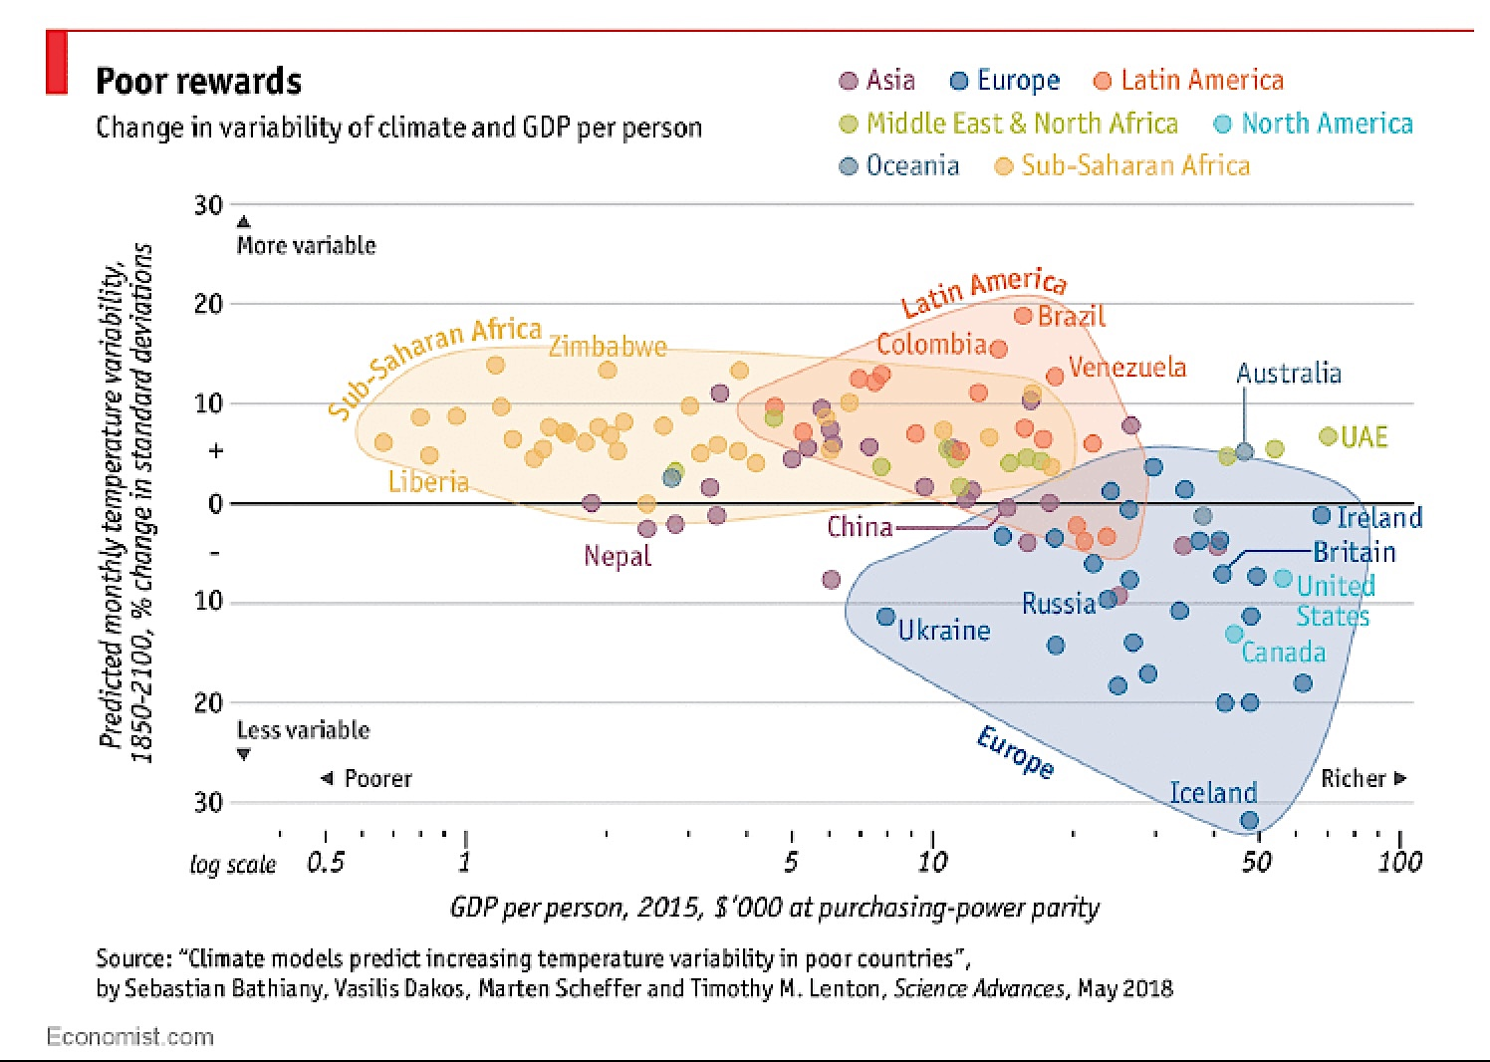
Climate in developing countries will become far more variable

Slide 16
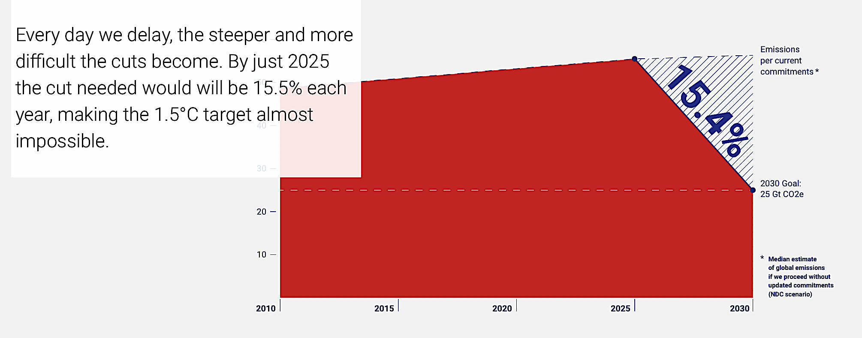
Annual emission reductions needed
by 2025 for a 1.5ºC maximum rise
Emissions Gap Report 2019, UN Environment

Slide 17
Proposed key climate actions
Based on current trends and climate change impacts to date, the following actions are needed if we are to minimize any increase in ambient temperatures above 1.5ºC.
Protect critical facilities and infrastructure (urban transport, emergency services, hospitals etc.) from climate change impacts.
Establish multi-stakeholder climate action authorities at national and local levels to establish relevant guidelines and to provide loans and grants for high-performance retrofits.
Support a shift from private to public transport.

Slide 18
Proposed key climate actions
Establish neighbourhood action strategies and performance targets.
Adjust VAT rates to provide incentives for renovation and disincentives for new construction
Freeze new construction in high-risk areas and limit new development in other areas
Launch deep green renovation programs to ensure high performance and low GHG emissions
Climate action items 8 to 18 – see full presentation.

Slide 19
Proposed key climate actions
Introduce incentives to move rapidly towards zero use of fossil fuels and to promote clean energy and renewables.
Mitigate urban heat island effect by increasing areas of parks and urban forests.
Encourage urban agriculture for local residents to reduce transport emissions and to increase neighbourhood access to fresh produce.
Provide short-term housing for population groups relocated by climate change impacts.
Establish refuge centres in low-income neighbourhoods for use during climate emergencies.

Slide 20
Other proposed climate actions
Develop thermal-solar-greywater system synergies in groups of buildings.
Limit peak electrical demand to minimize need for new generating capacity.
Minimize embodied energy and lifecycle emissions in new construction.
Ensure very high operating efficiencies of new buildings.
Strengthen equipment and appliance efficiencies.
Establish public building performance databases so that we can measure progress.

Slide 21
Integrated action

Slide 22
Our proposals for integrated actions
A logical action plan to respect the needs of both post-pandemic recovery and climate action will include the following measures:
Establish post-pandemic re-development authorities at national and local levels to establish or modify relevant regulations and to provide loans and grants for redevelopment.
Obtain major funding commitments from international financial institutions, including World Bank and IMF, and identify major private sources of capital.
Integrate climate and post-pandemic actions so that post-pandemic social and economic goals and 2050 zero GHG targets can be met.

Slide 23
Our proposals for integrated actions
To take into account the current trend for some population groups to move out to peripheral areas, develop urban planning strategies that include development of high-density mixed-use urban nodes around the urban core connected by public transit.

Slide 24
Existing patterns of high densities and mixed uses in urban centres are facing new pressures

Slide 25
The pandemic is causing some population groups to move out from central areas to suburban and exurban areas
This trend will cripple social and economic urban functions and will also cause higher transport emissions

Slide 26
We would serve climate as well as pandemic needs if we aim for high-density mixed-use nodes connected by public transport
Public transport

Slide 27
Our proposals for integrated actions
Launch housing programs for low-income populations as a major element of post-pandemic social equity and economic recovery measures.
For the above work, make use of buildings or parts of buildings that are now surplus to requirements.
Establish very demanding targets for energy efficiency and nearly-zero GHG emission buildings and urban public transport systems.
Reduce VAT levels for expenditures related to high-performance renovation work, to shift construction activity towards renovation.

Slide 28
To reduce emissions related to the building stock, we must focus on improving the energy performance of existing buildings
Total building stock
Existing buildings (95% to 97%)
Certified buildings
New buildings
Approximate proportions in the building stock (order of magnitude)

Slide 29
Our proposals for integrated actions
Place heavy emphasis on renovation with high performance targets for infrastructure, residential, public and commercial retail buildings.
Encourage natural and hybrid ventilation, improve mechanical ventilation capacities, and increase outdoor air ratios in ventilation systems.
Establish training programs to support the above initiatives.

Slide 30
Conclusions
An effort to simultaneously deal with climate action issues and post-Covid needs appears to be feasible.
Such efforts will offer great opportunities to integrate post-pandemic goals with those of climate action.

Slide 31
Nils Larsson larsson@iisbe.org
Andrea Moro <andrea.moro@iisbeitalia.org>

