Slide 1
designing a resilient planet Ken Yeang

Slide 2
key factorsm • resilience - creating a sustainable future for human society and for all species and their environments • biointegration - resilience depends on effective biointegration of human society and its systems with natural systems • ecocentricity - all action and design must based on science of ecology • frastructurein - action at level of infrastructures : nature, water, human society, technology(built systems) • constructed ecosystems - emulation and replication of ecosystem attributes • ecosystem services - emulation and replication of Nature provision of ecosystem services

Slide 3
key factorsm • resilience - creating a sustainable future for human society and for all species and their environments • biointegration - resilience depends on effective biointegration of human society and its systems with natural systems • ecocentricity - all action and design must based on science of ecology • infrastructure - action at level of infrastructures : nature, water, human society, technology(built systems) • constructed ecosystems - emulation and replication of ecosystem attributes • ecosystem services - emulation and replication of Nature provision of ecosystem services

Slide 4
smart resilience systems ecological resilience is adaptability to withstand or recover from unexpected action or impacts to the planet’s natural systems, requiring rapid adaptivity and corrective action to negative changes to natural systems to achieve positive outcomes.

Slide 5
global monitoring of ecosystems and biogeochemical cycles and response

Slide 6
key factorsm • resilience - creating a sustainable future for human society and for all species and their environments • biointegration - resilience depends on effective biointegration of human society and its systems with natural systems • ecocentricity - all action and design must based on science of ecology • infrastructure - action at level of infrastructures : nature, water, human society, technology(built systems) • constructed ecosystems - emulation and replication of ecosystem attributes • ecosystem services - emulation and replication of Nature provision of ecosystem services

Slide 7
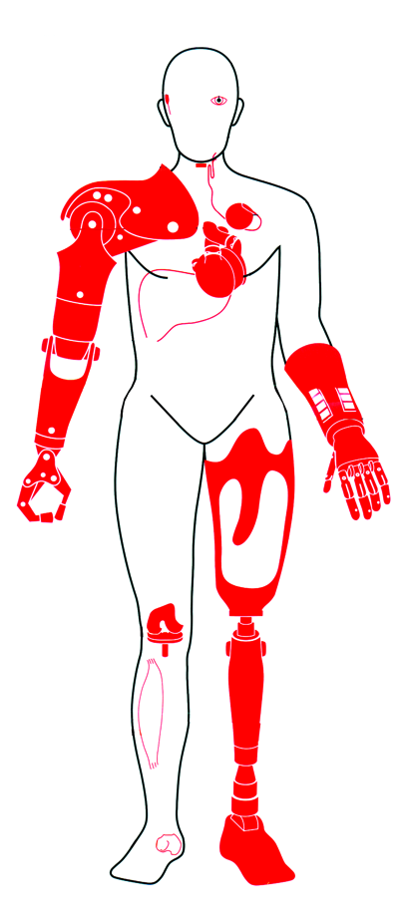
^{host organism}
^{effective}
^{biointegration}
^{prosthetic}
^{device}
^{human organism}

Slide 8
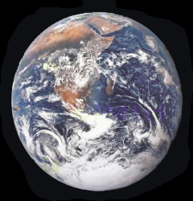
the biosphere
biogeochemical cycles
natural systems
^{host organism}
^{prosthetic}
^{device}
^{human organism}

Slide 9
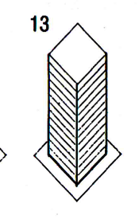
the biosphere
biogeochemical cycles
natural systems
^{host organism}
^{prosthetic}
^{device}
^{built systems}
^{technology}
^{artefacts}
^{semi-artificial systems}
^{lt} environment
^{human organism}

Slide 10
the biosphere
biogeochemical cycles
natural systems
^{host organism}
^{effective}
^{biointegration}
^{prosthetic}
^{device}
^{built systems}
^{technology}
^{artefacts}
^{semi-artificial systems}
^{lt} environment
^{human organism}

Slide 11
the biosphere
biogeochemical cycles
natural systems
^{host organism}
^{effective}
^{biointegration}
^{•physical}
^{•systemic}
^{prosthetic}
^{device}
^{built systems}
^{technology}
^{artefacts}
^{semi-artificial systems}
^{lt} environment
^{human organism}

Slide 12
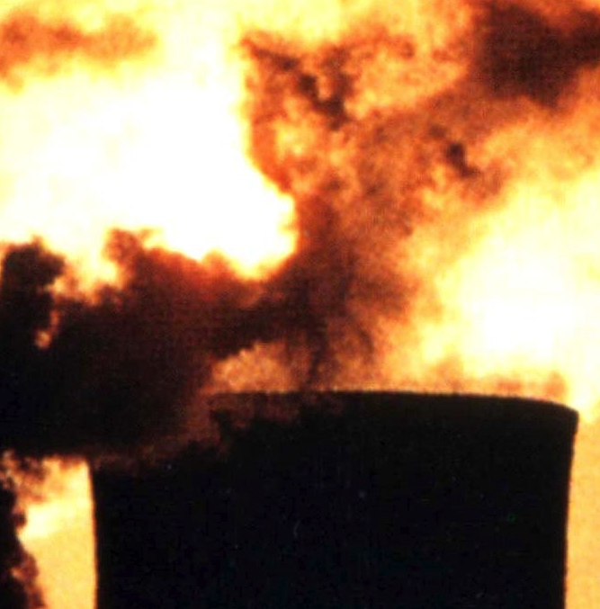
x
^{Ineffective}
^{biointegration}
environmental impairment
^{human organism}

Slide 13
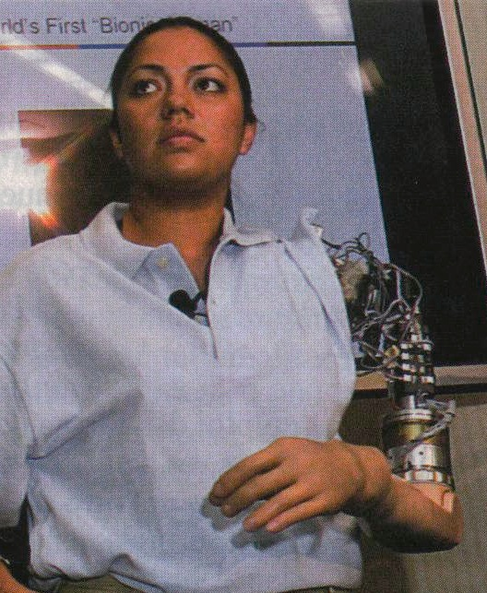
^{effective}
^{biointegration}
• systemic
(nervous systems
muscular system
other systems)
• physical
(septicity, etc.)
^{built environment built} environment
^{human organism}

Slide 14
key factorsm • resilience - creating a sustainable future for human society and for all species and their environments • biointegration - resilience depends on effective biointegration of human society and its systems with natural systems • ecocentricity - all action and design must based on science of ecology • infrastructure - action at level of infrastructures : nature, water, human society, technology(built systems) • constructed ecosystems - emulation and replication of ecosystem attributes • ecosystem services - emulation and replication of Nature provision of ecosystem services

Slide 15
within the biosphere are units in Nature that are the ecosystems
bbiogeochemical cycles
human
communities
built
environment
Plants Community
biological
constituents
biotic
community
of plants &
animals
Animal Community
Community of Plant
& Animal Microbes
ecosystems
ecosystem as ecology’’s model of nature
•structures
•production
processes
•energy
•artifacts
•emissions
Site characterized by
given climate features
physical
constituents
abiotic
physical
environment
Site characterized by
given edaphic features
Increasingly synthetic
loss of ecosystem services
environmental
impairment

Slide 16
key factorsm • resilience - creating a sustainable future for human society and for all species and their environments • biointegration - resilience depends on effective biointegration of human society and its systems with natural systems • ecocentricity - all action and design must based on science of ecology • infrastructure - action at level of infrastructures : nature, water, human society, technology(built systems) • constructed ecosystems - emulation and replication of ecosystem attributes • ecosystem services - emulation and replication of Nature provision of ecosystem services

Slide 17
this facilitates making the built environment green
the existing city greening of buildings is not effective
the existing city greening of buildings is not effective
Infrastructure
buildings
make the city’s infrastructure green facilitates making the entire city green
Infrastructure
buildings

Slide 18
this facilitates making the built environment green
the existing city greening of buildings is not effective
the existing city greening of buildings is not effective
Infrastructure
buildings
make the city’s infrastructure green facilitates making the entire city green
Infrastructure
buildings

Slide 19
ecological design as biointegration of infrastructures
ecological design defined as the biointegrating of four sets of infrastructures
ecology/nature
climate
ececosystems
flora & fauna
naturall resources
physical environment
biogeochemical
cycles
human activities
commerce
economic systems
life styles
mobility
recreation
food and diet
nature
humans
biointegrate
water
built
environment
built structures
production systems
(energy, artifacts,
Food products)
materials & waste
buildings
cities
utilities
hydrological cycle
ain aquatic ecosystems
ground water
rain, dew
lakes
bioswales
detention ponds
sustainable drainage
Rain

Slide 20
key factorsm • resilience - creating a sustainable future for human society and for all species and their environments • biointegration - resilience depends on effective biointegration of human society and its systems with natural systems • ecocentricity - all action and design must based on science of ecology • infrastructure - action at level of infrastructures : nature, water, human society, technology(built systems) • constructed ecosystems - emulation and replication of ecosystem attributes • ecosystem services - emulation and replication of Nature provision of ecosystem services

Slide 21
the ecosystem consists of both biotic and abotic constituents that act together to form a whole
human
communities
built
environment
Plants Community
biological
constituents
biotic
community
of plants &
animals
Animal Community
Community of Plant
& Animal Microbes
ecosystems
•structures
•production
processes
•energy
•artifacts
•emissions
Site characterized by
given climate features
physical
constituents
abiotic
physical
environment
Site characterized by
given edaphic features
Increasingly synthetic
loss of ecosystem services
environmental
impairment

Slide 22
these interact in very complex ways
human
communities
built
environment
community
of plants &
animals
plant communities
animal communities
ecosystems
•structures
•production
processes
•energy
•artifacts
•emissions
climate
hydrologic
processes
physical
environment
geology
soils
Increasingly synthetic
loss of ecosystem services
environmental
impairment

Slide 23
creating hybrid ecosystems: the key ecosystem attributes to be emulated and replicated?
• ecosystems biological structure
• ecosystems biodiversity
• ecosystems connectivity and nexus
• ecosystems provision of ecosystem services
• ecosystems biointegration
• ecosystems responsiveness to climate
• ecosystems use and cycling of materials
• ecosystems hydrology
• ecosystems symbiosis
• ecosystems homeostasis,
• ecosystems food production
• ecosystems succession
human
communities
built
environment
key ecosystem attributes

Slide 24
creating hybrid ecosystems: the key ecosystem attributes to be emulated and replicated?
• ecosystems biological structure
• ecosystems biodiversity
• ecosystems connectivity and nexus
• ecosystems provision of ecosystem services
• ecosystems biointegration
• ecosystems responsiveness to climate
• ecosystems use and cycling of materials
• ecosystems hydrology
• ecosystems symbiosis
• ecosystems homeostasis,
• ecosystems food production
• ecosystems succession
human
communities
built
environment
key ecosystem attributes

Slide 25
augment built systems with biotic constituents as habitats
provision of ecosystem servces by augmenting the buiil environment
close weaving of
biotic constituents
Into urban fabric
centralised planting
dispersed planting
“spotty” pattern
“stepping stones”
continuous planting
“corridors and fingers”
juxtapositioning
Intermixing
enhanced
intermixing
integrating

Slide 26
key factorsm • resilience - creating a sustainable future for human society and for all species and their environments • biointegration - resilience depends on effective biointegration of human society and its systems with natural systems • ecocentricity - all action and design must based on science of ecology • infrastructure - action at level of infrastructures : nature, water, human society, technology(built systems) • constructed ecosystems - emulation and replication of ecosystem attributes • ecosystem services - emulation and replication of Nature provision of ecosystem services

Slide 27
emulation of provision of key ecosystem services without human intervention
ec
• production of oxygen
• maintenance of biological and
genetic diversity
• purification of water and air
• storage, cycling and global
distribution of freshwater
• regulation of the chemical
composition of the atmosphere
• maintenance of migration and
nursery habitats for wildlife
• decomposition of organic
wastes
• sequestration and
detoxification of human and
industrial waste
*natural pest and disease
control by insects, birds, bats, and
other organisms
• production of genetic library for food,
fibers, pharmaceuticals, and materials
• fixation of solar energy and
conversion into raw materials
• management of soil erosion and
sediment control
• flood prevention and regulation of
runoff
• protection against harmful cosmic
radiation
• regulation of the chemical
composition of the oceans
• regulation of the local and global
climate
• formation of topsoil and
maintenance of soil fertility
• production of grasslands,
fertilizers, and food
• storage and recycling of nutrients
ecosystem
services

Slide 28
• production of oxygen
• maintenance of biological and
genetic diversity
• purification of water and air
• storage, cycling and global
distribution of freshwater
• regulation of the chemical
composition of the atmosphere
• maintenance of migration and
nursery habitats for wildlife
• decomposition of organic
wastes
• sequestration and
detoxification of human and
industrial waste
*natural pest and disease
control by insects, birds, bats, and
other organisms
• production of genetic library for food,
fibers, pharmaceuticals, and materials
• fixation of solar energy and
conversion into raw materials
• management of soil erosion and
sediment control
• flood prevention and regulation of
runoff
• protection against harmful cosmic
radiation
• regulation of the chemical
composition of the oceans
• regulation of the local and global
climate
• formation of topsoil and
maintenance of soil fertility
• production of grasslands,
fertilizers, and food
• storage and recycling of nutrients
• production of oxygen
ecosystems

Slide 29
• production of oxygen
• maintenance of biological and
genetic diversity
• purification of water and air
• storage, cycling and global
distribution of freshwater
• regulation of the chemical
composition of the atmosphere
• maintenance of migration and
nursery habitats for wildlife
• decomposition of organic
wastes
• sequestration and
detoxification of human and
industrial waste
*natural pest and disease
control by insects, birds, bats, and
other organisms
• production of genetic library for food,
fibers, pharmaceuticals, and materials
• fixation of solar energy and
conversion into raw materials
• management of soil erosion and
sediment control
• flood prevention and regulation of
runoff
• protection against harmful cosmic
radiation
• regulation of the chemical
composition of the oceans
• regulation of the local and global
climate
• formation of topsoil and
maintenance of soil fertility
• production of grasslands,
fertilizers, and food
• storage and recycling of nutrients
• sequestration and
detoxification of human and
industrial waste

Slide 30
• production of oxygen
• maintenance of biological and
genetic diversity
• purification of water and air
• storage, cycling and global
distribution of freshwater
• regulation of the chemical
composition of the atmosphere
• maintenance of migration and
nursery habitats for wildlife
• decomposition of organic
wastes
• sequestration and
detoxification of human and
industrial waste
*natural pest and disease
control by insects, birds, bats, and
other organisms
• production of genetic library for food,
fibers, pharmaceuticals, and materials
• fixation of solar energy and
conversion into raw materials
• management of soil erosion and
sediment control
• flood prevention and regulation of
runoff
• protection against harmful cosmic
radiation
• regulation of the chemical
composition of the oceans
• regulation of the local and global
climate
• formation of topsoil and
maintenance of soil fertility
• production of grasslands,
fertilizers, and food
• storage and recycling of nutrients
ecosystems
provision of
‘ecosystem services
without human
intervention
• sequestration and
detoxification of human and
industrial waste

Slide 31
summary key factors in ecological designm • resilience - creating a sustainable future for human society and for all species and their environments • biointegration - resilience depends on effective biointegration of human society and its systems with natural systems • ecocentricity - all action and design must based on science of ecology • infrastructure - action at level of infrastructures : nature, water, human society, technology(built systems) • constructed ecosystems - emulation and replication of ecosystem attributes • ecosystem services - emulation and replication of Nature provision of ecosystem services

Slide 32
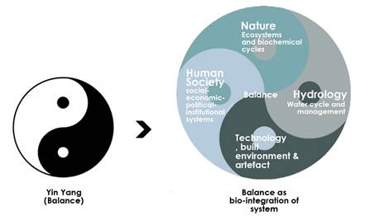
ecosystems: symbiosis

Slide 33
ecological design as biointegration of infrastructures
ecological design defined as the biointegrating of four sets of infrastructures
ecology/nature
climate
ecosystems
flora & fauna
nat. resources
physical environment
biogeochemical
cycles
activities
commerce
economic systems
life styles
mobility
recreation
food and diet
nature
humans
biointegrate
water
built
environment
built structures
production systems
(energy, artifacts, food
products)
materials & waste
buildings
cities
utilities
rain
waterways
ground water
dew
lakes
bioswales
detention ponds

Slide 34
ecological design as biointegration of infrastructures
poticy intervention, technological interventions, institutional changes
• A resilient future is dependent
on the effective biointegration
of all human activities and its
Systems with Nature
• All human activities and systems
must be ecocentric and be guided
by the Science of Ecology,
• Our built encieonment must
Emulate and replicate the attributes
of ecosystems as constructed ecosystems.
• Our technological systems must be
reinvented seek to provide ecosystem services.
nature
humans
biointegrate
water
built
environment

Slide 35
end

