Slide 1
October 2020
Shaping Smart Urban Governance
Calum Handforth
UNDP Advisor, Smart Cities and Digitalisation

Slide 2
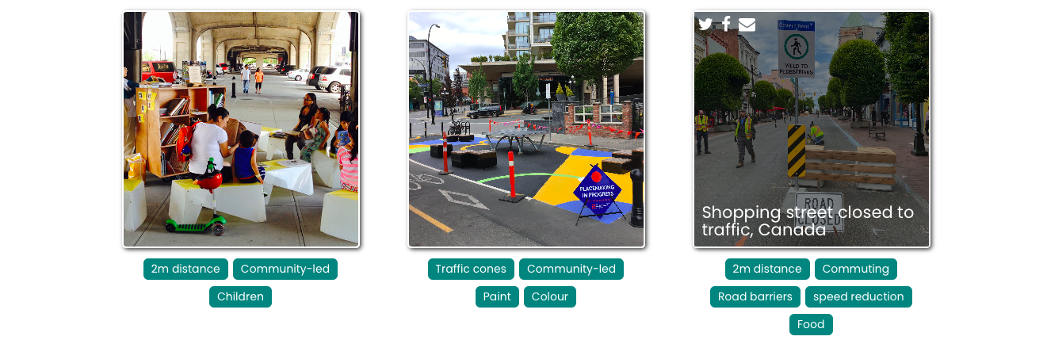
GOVERNANCE SOMETIMES NEEDS TO BE AGILE…
Source: https://tactical.space

Slide 3
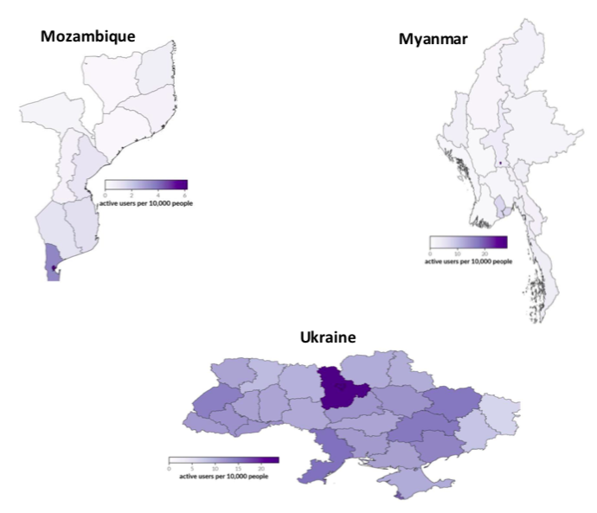
…BUT MUST ALWAYS BE INCLUSIVE.
Indonesia: Rich areas can restrict their movements about twice as much as their poorer counter parts
Representativeness of mobility data
Source: https://www.unicef.org/innovation/media/13811/file

Slide 4
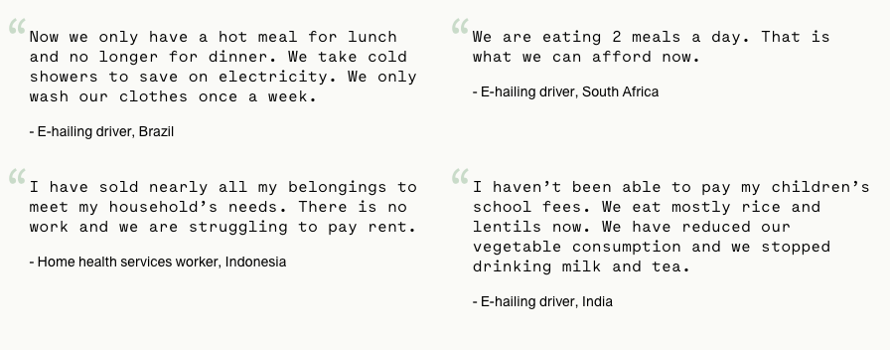
‘SMART’ URBAN GOVERNANCE: BIG AND LEAN DATA
Source: https://app.60decibels.com/covid-19

Slide 5
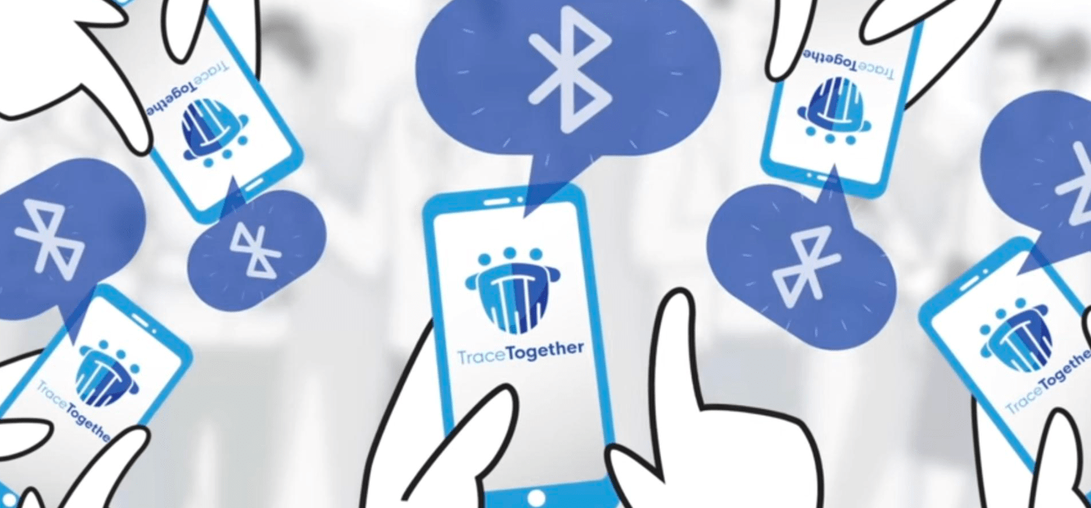
“TraceTogether does not replace the contact tracing process. Instead, we see it as an important tool in the toolbox of contact tracers. It is not sufficient to rely on technology alone, as we need the expertise in public health and communicable diseases to make sense of the data collected
using this technology,”

Slide 6
WE NEED TO BE BUILDING ON SUCCESS
Click on the screen to view the toolkit
$100m+
Value of Tools
50+
Countries

Slide 7
THE IMPORTANCE OF FEEDBACK LOOPS
Analysing (individually) 1,100+ audio-recorded questions each week…

Slide 8
Thank you
Calum Handforth
Advisor, Smart Cities and Digitalisation
calum.handforth@undp.org

