Slide 1
GFHS: financing for resilient urban infrastructure
16 October, 2020

Slide 2
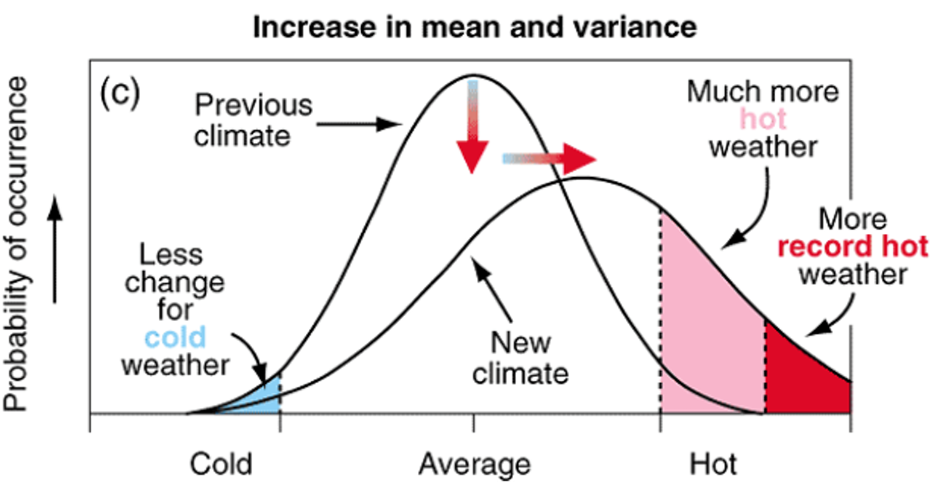
TCFD Summary: Physical Risk Modelling

Slide 3
TCFD Summary: Physical Risk Modelling

Slide 4
Research programme: physical climate risk and asset value

Slide 5
Thank you
Contact information
Matthew Ulterino Property Investment Project Coordinator UNEP Finance Initiative | Tel: +1 (585) 417-0615 (US) Tel: +44 (0)20 8133 8620 (UK) matthew.ulterino@un.org
Anna Murray (PWG Co-Chair) BentallGreenOak Calvin Kwan (PWG Co-Chair) Link REIT | anna.murray@bentallgreenoak.com calvin.kwan@linkreit.com

