Slide 1
China: the case of developing a majeure Green Finance market and examples from the Sino-German cooperation on climate change
Global Forum on Human Settlements 2020
Thematic Forum 2A: Financing for Resilient Urban Infrastructure
Dr. Alexander Fisher| 15 Oct 2020

Slide 2
Agenda
Green Finance in China
Three Examples of Financing Urban Resilient Infrastructure in China:
Sponge City Xiamen
Wind Power in Hohhot
PV in Qingyuan County

Slide 3
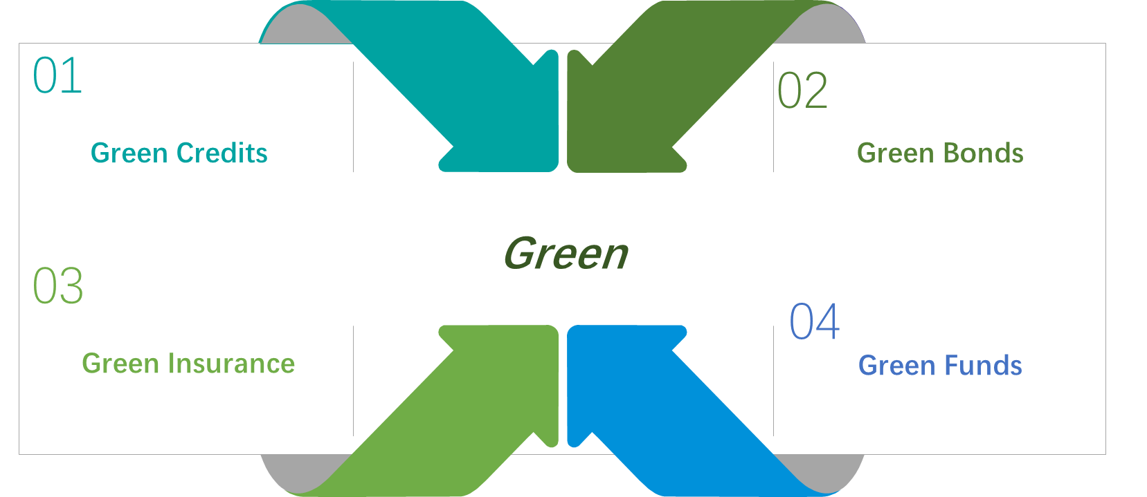
1.1 Green Financial Products and Market

Slide 4
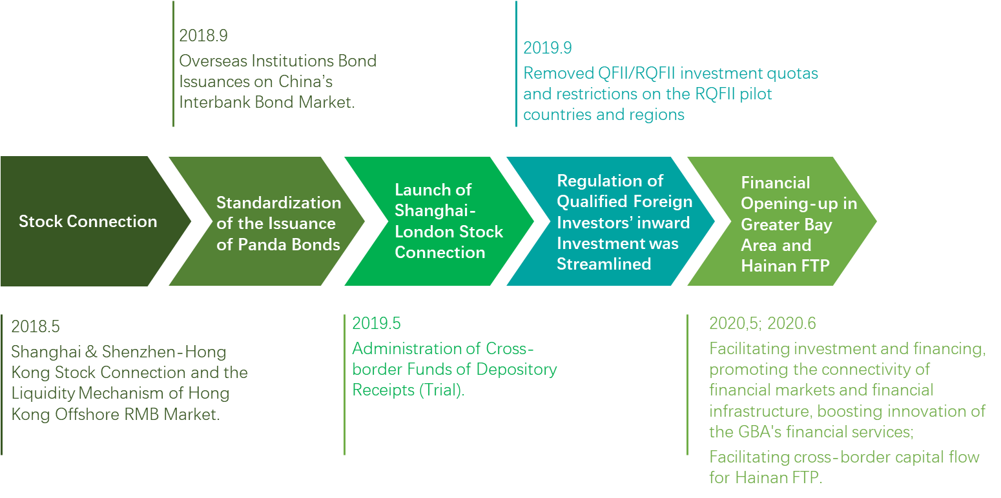
1.2 Opening of Green Financial Market

Slide 5
1.3 Green Credits
Table 1.1 Green credit balance of
21 largest commercial banks in China (Trillion USD)
Table 1.2 Green Credit Balance at 2018 end, by banks
Source: CBIRC
Calculated by annal averaged exchange rate.
Source: CBIRC and CSMAR

Slide 6
1.4 Green Bonds
Table 1.3 Amount and Number of green bonds issued by Chinese institutions since 2016
Source: CBI and Xinhua Green Bond Database

Slide 7
1.5 Co-chairing the G20 Green Finance Study Group
China initiated the Green Finance Study Group (GFSG) during its G20 Presidency in 2016.
Co-chaired by the central banks of China and the UK.
Featuring green finance in the G20 agenda for the first time.
Recommendations were welcomed by G20 leaders at the Hangzhou Summit in September 2016 and written into a series of official documents, bringing green finance to wider international attention.
Momentum continued in the following two years under Germany and Argentina’s G20 Presidencies.

Slide 8
1.6 Participating in the NGFS as a Founding Member
In December 2017, eight central banks and regulators, including the PBC, formed Network for Greening the Financial System (NGFS).
Dr. Ma Jun, representing PBoC, chaired the Supervision Workstream, to enable central banks and supervisors to better understand and manage the environmental and climate-related financial risks.
As of July 2020, the NGFS has expanded to 69 members and 13 observers.
Three workstreams have been launched under the NGFS to facilitate research and knowledge sharing on managing environmental risks, as well as scaling up green finance at the national level.
A collection of methodologies and tools for environmental risk analysis by financial firms is forthcoming in 2020. Chinese financial firms had contributed their experiences to the collection while learning from their international peers.

Slide 9
1.7 Greening Investments in the Belt and Road
Green Investment Principles for the Belt and Road (GIP).
Aim to incorporate low-carbon and sustainable development into the BRI by encouraging financial institutions and corporations involved and invested in B&R projects to sign up to a voluntary code of practice.
Includes seven principles at three different levels: strategy, operations, and innovation.
37 signatories and 12 supporting institutions, representing 14 countries and regions. Most of these members are large international financial institutions holding or managing a total asset of more than USD 41 trillion.

Slide 10
1.8 Capacity Building for Green Finance
Green Finance Leadership Program (GFLP).
Launched by Tsinghua University with the China Council for International Cooperation on Environment and Development (CCICED) and the IFC-supported Sustainable Banking Network (SBN) in 2018.
Invite global experts and representatives to share their expertise and experience.
As of September 2019, the GFLP has successfully held four events in China, Morocco, and Kazakhstan, with more than 600 participants from 60 countries and regions.
In 2020, first GFLP capacity building webinar, on information disclosure, has attracted over 2,000 participants from all over the world. More are forthcoming in the second half of the year.

Slide 11
Agenda
Green Finance in China
Three Examples of Financing Urban Resilient Infrastructure in China:
Sponge City Xiamen
Wind Power in Hohhot
PV in Qingyuan County

Slide 12
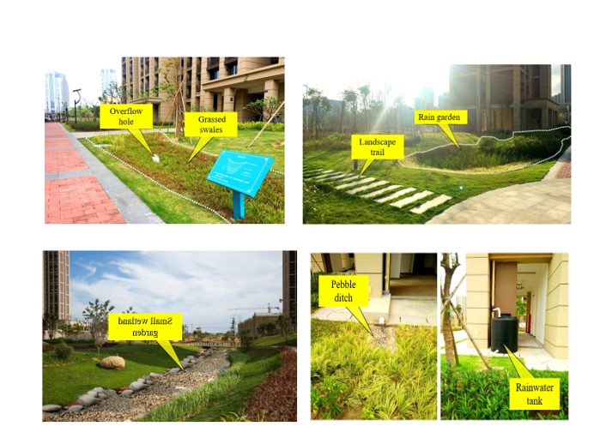
2.1 Sponge City Xiamen – Using PPP to promote resilience
Located in southeast coastal areas of China, comprises a total area of 2089.39 km² including the Island of Kulangsu, and inland coastal areas.
Residential population :4.29 million (2019) with an urbanization rate of 89.2%.
Annual average rainfall in Xiamen is 1530 mm, over 80% of which falls between March and September.
Xiamen was selected in 2015 as one of the “sponge cities” as pilot cities for environmentally sustainable flood control projects.
Source: Fujian Provincial Climate Center. Technical Report on the Research on the Characteristics of Precipitation Temporal and Spatial Changes in Xiamen City in the Past 60 Years, 2016, Xiamen: Xiamen Meteorological Bureau
Lin X Y, Zhang S M, Chen D W, YUAN F C. Variability of Inter-annual and decadal sea level and its prediction along Fujian coastal area. Marine Forecasts, 2014, 031(05):63-68.
Xiamen City Planning and Design Institute, Xiamen City Sponge City Special Plan, 2016, Xiamen: Xiamen Municipal Gardening Bureau.

Slide 13
2.1 Sponge City Xiamen
Construction Path of Sponge City in Xiamen

Slide 14
Investment Estimation of Recent Construction
2.1 Sponge City Xiamen – Financing Mechanism
Number | Project | Investment (100 million yuan)
1 | Pollution prevention and control | 77.90
2 | Ecological water system | 28.75
3 | Drainage and waterlogging prevention | 12.54
4 | Garden and green land | 14.91
5 | Road and traffic | 98.55
6 | Sponge community | 67.25

Slide 15
Schematic Diagram of PPP Mode of Sponge City Construction
2.1 Sponge City Xiamen – Financing Mechanism

Slide 16
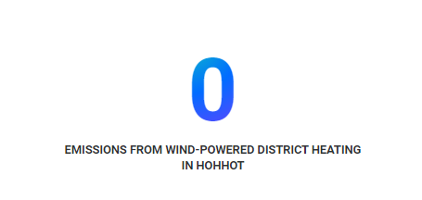
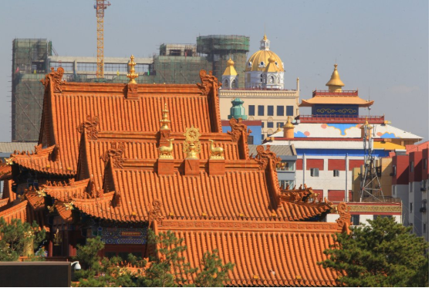
2.2 Wind Power in Hohhot
Source: ADB

Slide 17
2.2 Wind Power in Hohhot
The region has 18 GW of installed wind capacity, 25% of the national total, but struggles to make use of the resource, with curtailing rates of more than 45%.
Replacing coal with wind energy to heat homes will reduce the thick, toxic smog that often fills Hohhot’s cold air, and bring an end to the associated health problems for the city’s residents. With national goals to meet 15% of the country’s total energy demand with renewables by 2020, this sort of initiative will need to be supported and scaled to a greater extent.
An outstanding feature of the initiative and driver of its success is a new kind of three-party business model, creating more advantageous business circumstances for the wind farm, the grid, and the heating company.
ADB provided a $150 million loan.

Slide 18
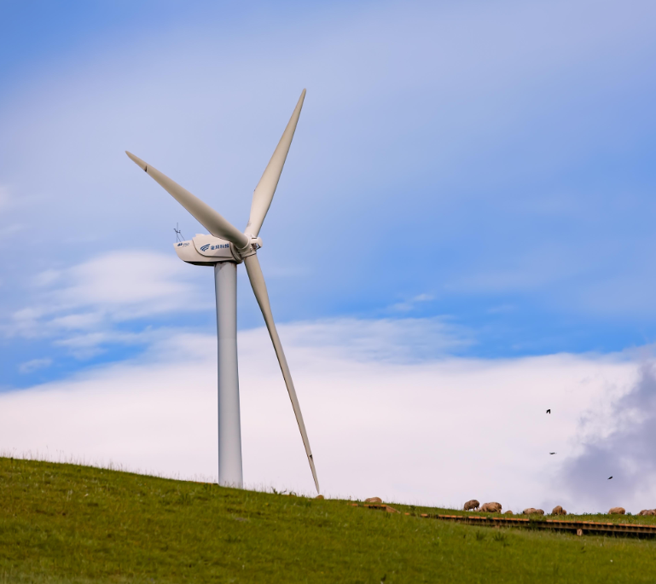
2.2 Wind Power in Hohhot
Under a new pilot scheme, the city is using the region’s massive wind resources, which blow the hardest in winter, to power two new 25 MW electric boilers. The new boilers are feeding into an expanded district heating network, which covers approximately two-thirds of the city.

Slide 19
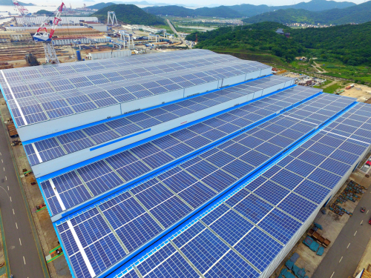
2.3 PV in Qingyuan County
In Qingyuan County, Zhejiang Province, a collectively PV project owned by 6 villages and a PV company was initiated in 2020. The PV project will be used for generating electricity for a bamboo producing factory in the county.
Financing mode: co-financed by villagers and a company. Villagers of each village invest a maximum share capital of 200,000 yuan on a voluntary basis, and enjoy a fixed dividend of not less than 10% every year.
The actual construction area of photovoltaic panels will be not less than 12,000 square meters, and the total investment is about 15 million yuan. The installed capacity will be about 3,000 to 4,000 kilowatts.
Source: http://guangfu.bjx.com.cn/news/20200703/1086185.shtml

Slide 20
Thank you for your attention!
For more information please visit:
www.climatecooperation.com
Or contact:
Dr. Alexander Fisher
GIZ Beijing Office
Program Director for Climate Change Cooperation, Environment, and Climate Friendly Urban Development
alexander.fisher@giz.de

