Slide 1
The 15th Annual Session of Global Forum on Human Settlements & Sustainable Cities And Human Settlements (GFHS 2020)
Aligning the sustainable development goals to the small-scale fisheries guidelines for coastal communities
Alicia Said
Director for Fisheries
Department of Fisheries and Aquaculture, Malta

Slide 2


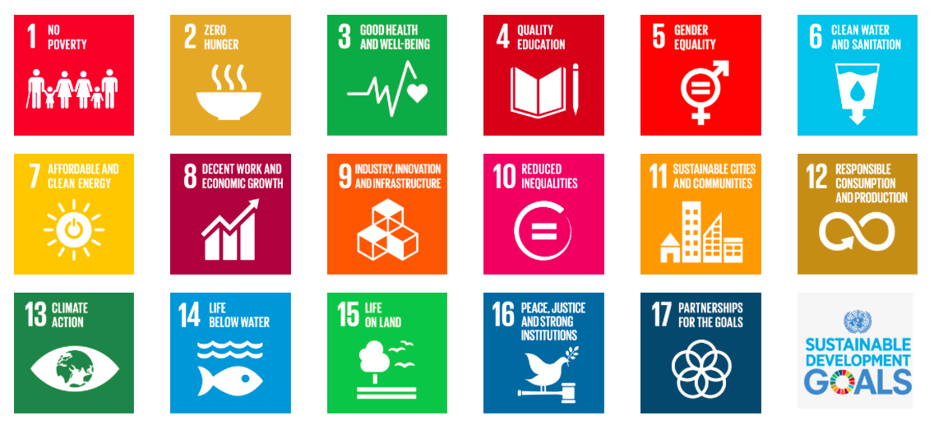

Slide 3
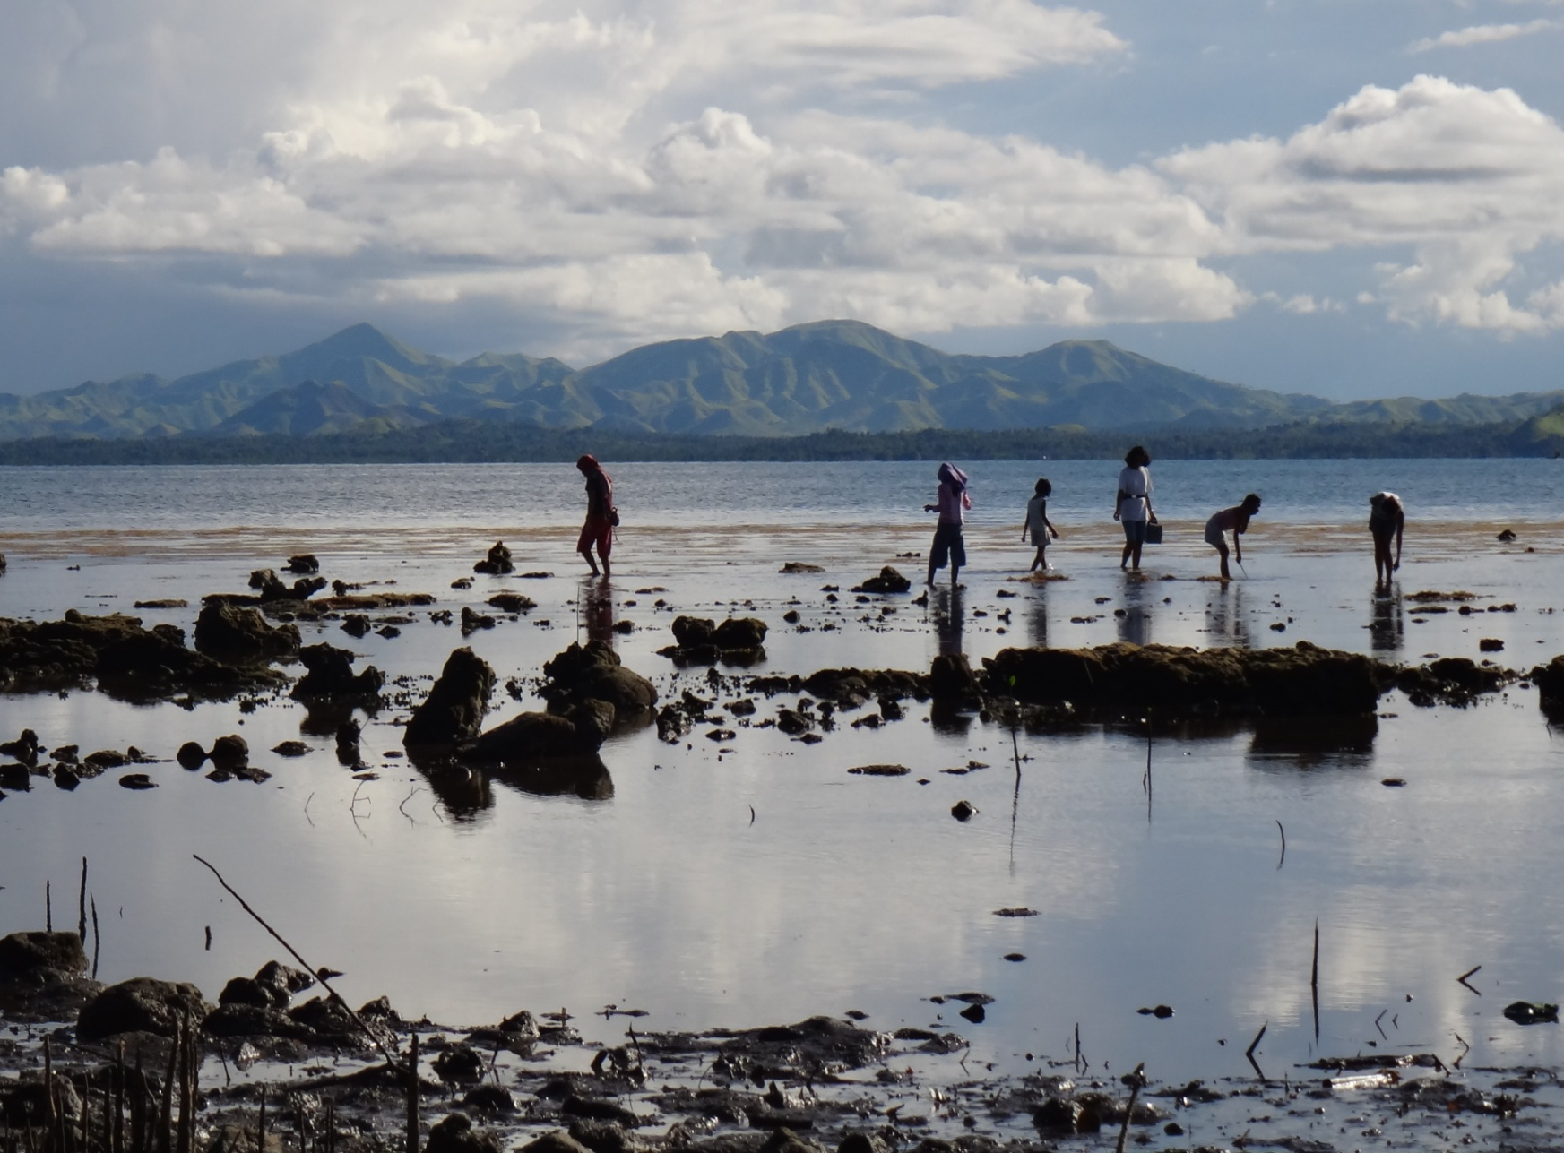
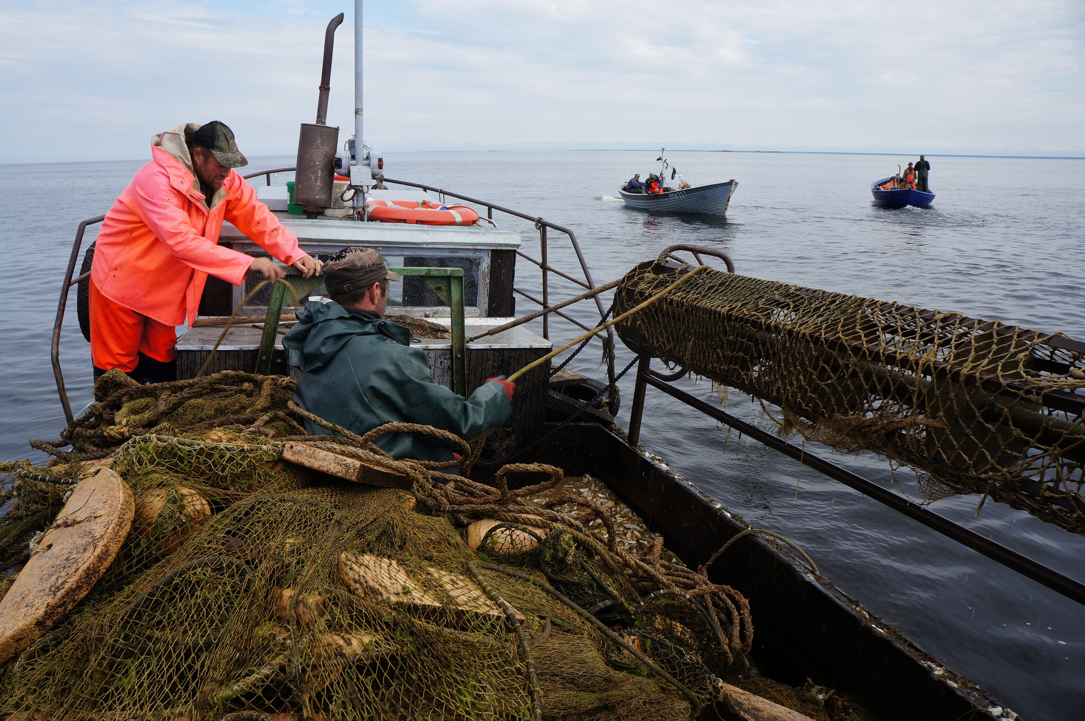
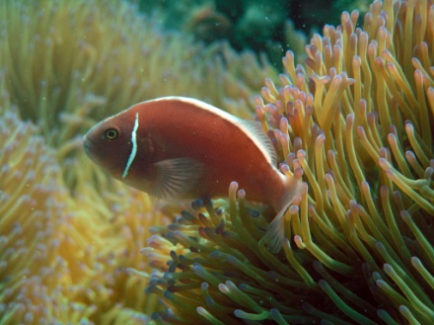
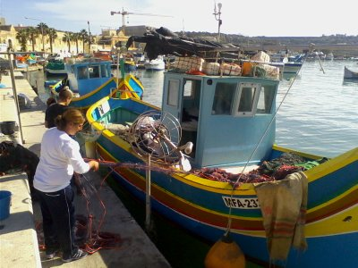
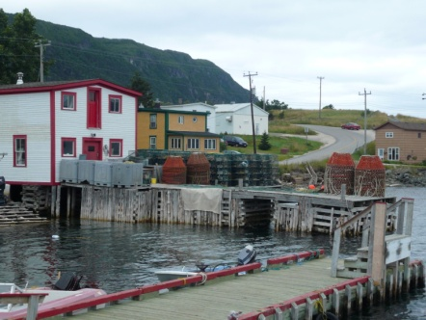
Coastal Fishing Communities: Major concerns
Coastal fisheries are highly affected by these concerns
Ecosystem health
Social justice
Livelihoods
Food security
Small-scale fisheries can make major contribution to address these concerns
COVID-19 has caused unpredictable impact on coastal fisheries due to impacts on the value chain.

Slide 4
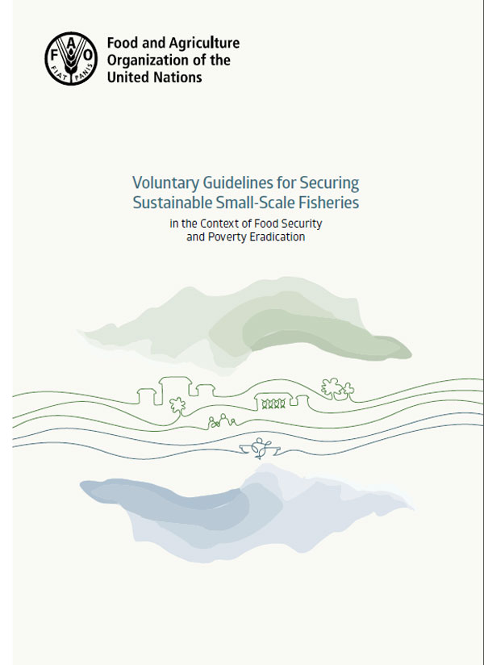
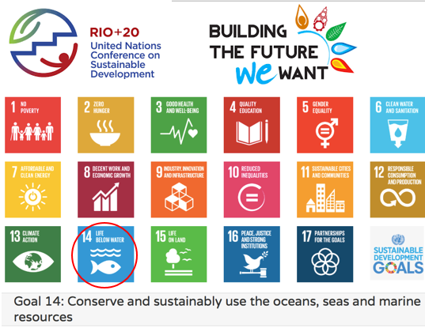
Aligning UN SDGs and SSF Guidelines for sustainable small-scale fisheries
FAO Voluntary Guidelines for SSF
UN Sustainable Development Goals
SDG14b: Provide access for small-scale artisanal fishers to marine resources and markets

Slide 5
Aligning SDG and SSF Guidelines
Both instruments have a reciprocated relationship as they both are focused on engendering sustainable development
Collectively they can serve as the ‘blue print’ to shape the trajectories of sustainable development of small-scale fisheries in Europe
FAO SSF Guidelines
Sustainable
Development
Goals (SDGs)
SUSTAINABILITY
SDG14b on its own won’t work for sustainable small-scale fisheries
Sustainability of small-scale fisheries depends on other SDGs
Small-scale fisheries are necessary for the achievement of SDGs.
Let’s look at the commonalities between SSF and SDGs….

Slide 6
SDG for SSF; SSF for SDG
Sustainable Development Goals (SDGs) | SDGs for SSF | SSF for SDGs
SDG 1: No poverty | Provision of development opportunities to fishing communities | Traditional systems of artisanal growth are resilient and sustainable
SDG 2: Zero Hunger | Provision of access to fisheries resources and fishing grounds | SSF provide food for local communities
SDG 3: Good Health and Wellbeing | Fishing as a way of life: social and human wellbeing | SSF provide locally-caught high nutrient fish
SDG 5: Gender equality | Provide fisherwomen with equal rights as their male counterparts | Women’s SSF organizations endeavour to empower women
SDG 8: Decent Work and Economic Growth | Decent socio-economic conditions, and broadened scope for artisanal growth | SSF communities reproduce economic growth through positive externalities (e.g. tourism)
SDG 9: Industry, Innovation and Infrastructure | Improvements in the post-harvest sector through appropriate infrastructure and value-addition activities | Fishing communities engage in innovative systems to improve their industry

Slide 7
SDG for SSF; SSF for SDG
Sustainable Development Goals (SDGs) | SDGs for SSF | SSF for SDGs
SDG 10: Reduced Inequalities | A human-rights based approach to distribution of fishing opportunities | SSF are embedded in a level-playing field system with equity-based access to fisheries resources
SDG 11: Sustainable cities and communities | An integrated approach to development of fishing-dependent communities. | SSF demonstrate social cohesion which is an important component for sustainable communities
SDG 12: Responsible Consumption and Production | Consideration of the impact of international trade on the products of small-scale fisheries through transparent trade systems. | SSF low-impact fisheries provide a contribution to responsible production of fisheries resources
SDG 14: Life Below Water | Strengthening sustainable small-scale low-impact fisheries | Low-impact fisheries are generally more sustainable
SDG 16: Peace, Justice and Strong Institutions | Strengthening fisheries governance systems towards sustainable fisheries. | The social capital of SSF communities is fundamental for strong institutions
SDG 17: Partnership for Goals | Development multi-scalar partnerships to strengthen collaboration towards achieving the SDGs. | SSF demonstrate a collaborative role towards knowledge sharing and partnerships.

Slide 8
Notes:
Intensity of scale
As can be expected, SDG14, which targets Life Below Water, has a total score of 42 occurrences, with the strong emphasis on “Governance of tenure.” SDG16 on Peace, Justice and Strong Institutions has an intensity score of 33, and it is the only goal in the SDGs that touches upon all aspects of the SSF Guidelines. The next two SDGs with moderately high intensity score are SDG5 on Gender Equality (n= 26), and SDG8 on Decent Work and Economic Growth (n = 22). Here, the focus on gender equality in the Guidelines touches on all but two aspects, with a specific section in the SSF guidelines (SSF 8) entirely dedicated to the topic. The same complementarity is present for the SDG8 on Decent work and economic growth, with SSF 6 being fully focused on ‘Social Development, Employment and Decent Work’, along parallel sections in the SSF Guidelines that touch upon this aspect.

Slide 9
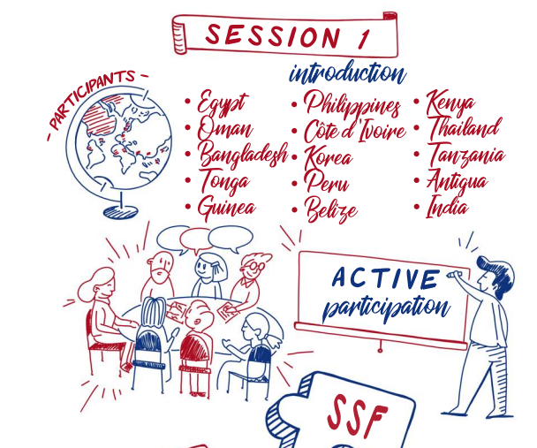
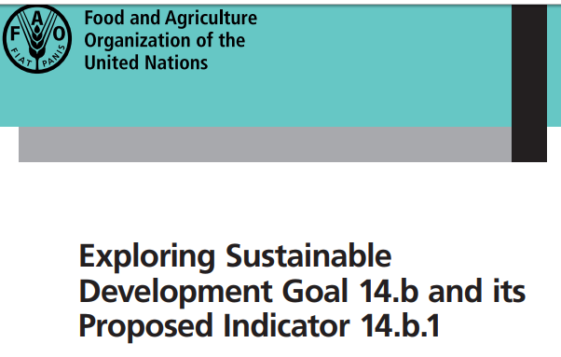
Elevating the profile of coastal communities
FAO is currently conducting an exercise for the implementation (indicators) of SDG14b in the context of developing countries

Slide 10
Achieving sustainability through transidisciplinarity
Sustainability concerns and issues are interconnected: access to resources, violation of human rights, food insecurity, overfishing, failed institutions
Capturing the roots of the problem: an integrated approach that goes across, between and beyond different disciplines and knowledges.
Broadening the perspective: all connections are mapped out in a way that gives a holistic understanding of the situation.
Empirical research and context-specific governance for small-scale fisheries sustainability through SDG-SSF alignment.
Notes:
Power issues
Understanding the underlying transactions benefitting corporate growth at the expense of SSF is something that can actually halt the process of implementing the SSF guidelines…
Understanding the political structures and problems of elite capture
Based on these outcomes, then we can speak of possible governance shifts and transformations that can improve SSF sustainability
SSF Guidelines are there and will bring benefits to the sector; but who is in the lead to bring the change? Are leaders supportive of the status quo?
A lot of empirical research supports the need for context-specific governance systems, but context-specific governance systems need to be based on a lot of empirical research, so the focus should be on how we can achieve such effective governance to suit the specific needs of fishing communities.

Slide 11
Moving Forward – Post-COVID 19
Discussing Sustainability (Science-policy )
Deciphering Sustainability (Research)
Defining Sustainability (Policy Implementation)

Slide 12
Discussing Sustainability
With the UN Sustainable Development Goals (SDGs) paving the research and policy trajectories for the next decade and beyond, a discussion on the sustainability of small-scale fisheries is timely, also to propel a conversation about the integrated role of social and natural science research needed to achieve these ambitious goals.

Slide 13
Deciphering Sustainability
Although often considered as a (fish)ery problem, the sustainability of coastal fisheries is much more than that, as it is interconnected to various systems including the community, the markets, the political economy, and other structures which although not always visible, have a determinant role in the viability equation of small-scale fisheries.

Slide 14
Defining Sustainability
Defining sustainability: The call for an integrated approach in the implementation of the SDGs and the SSF Guidelines is applicable to all countries, especially those where the values and the importance of coastal communities are ignored, and where the current policy directions have the tendency to further marginalize them.

Slide 15
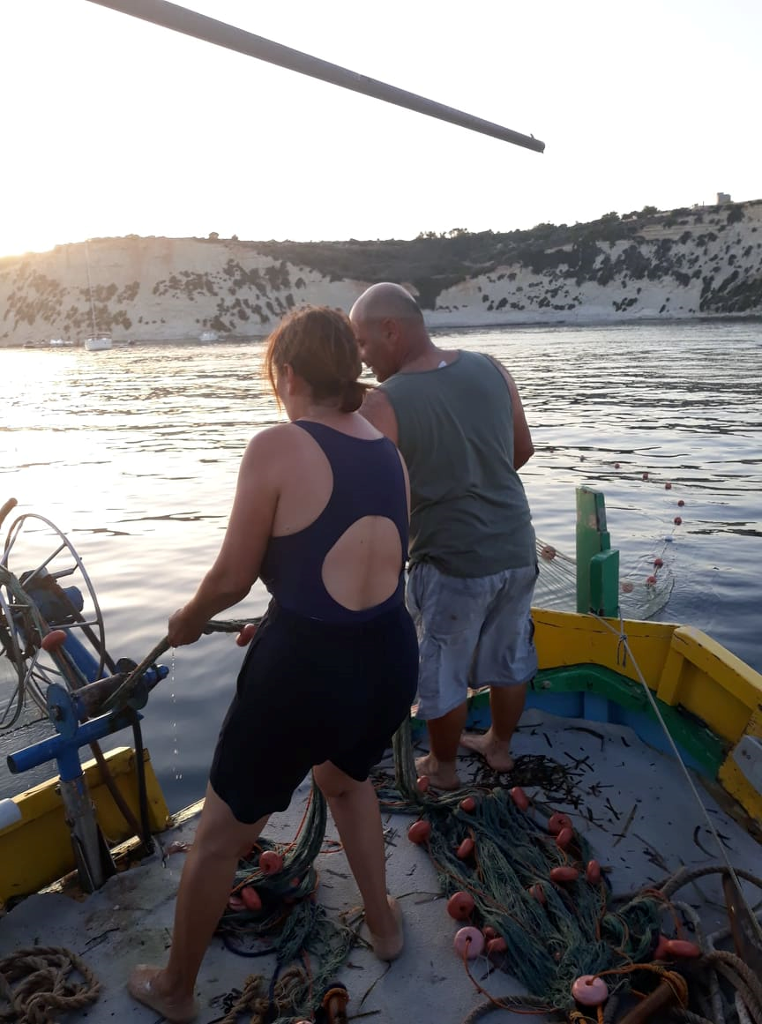

Thank You

