Slide 1
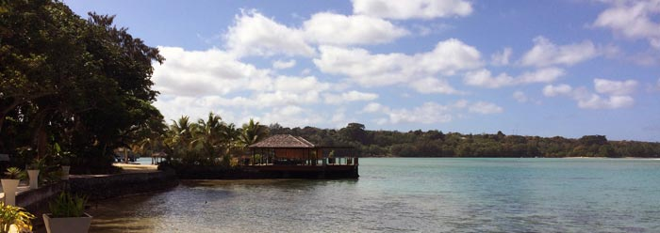
Costal tourism, impacts on vulnerable populations and options for recovery The 15th Annual Session of Global Forum on Human Settlements 2020 David Vivas, Legal Affairs Officer and Claudia Contreras, Economic Affairs Office 15 October 2020

Slide 2
Outline
Main trends tourism and coastal tourism
Impact of COVID-19
Country measures of measures taken to respond to COVID-19 in the coastal tourism sector
Short, Medium- and Long-Term measures

Slide 3
Global trends
Tourism sector: 29% of the world’s services exports and 300 million jobs globally in 2019.
Before the COVID-19 pandemic the tourism sector was growing at a 4% rate and contributed a record $1.6 trillion and more than 300 million jobs to the world economy (2018).
About half of all tourists choose a coastal destination for their vacations.
Coastal and maritime tourism is the largest of all blue economy sectors
Cruise tourism almost into a halt with 76 per cent of all booking in 2020 cancelled or postponed due to border and sanitary measures and uncertainty (KPMG, July 2020)
Notes:
Tourism is a critical sector of the international economy. In 2019, the tourism sector accounted for 29 per cent of the world’s services exports and about 300 million jobs globally

Slide 4
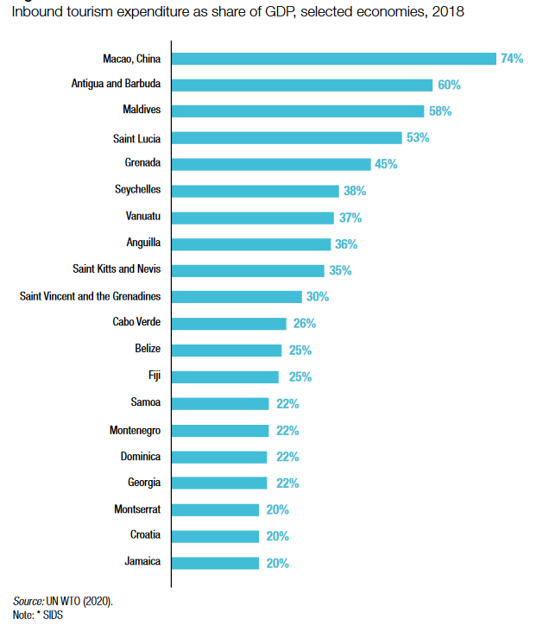
Inbound tourism expenditure as share of GDP, 2018

Slide 5
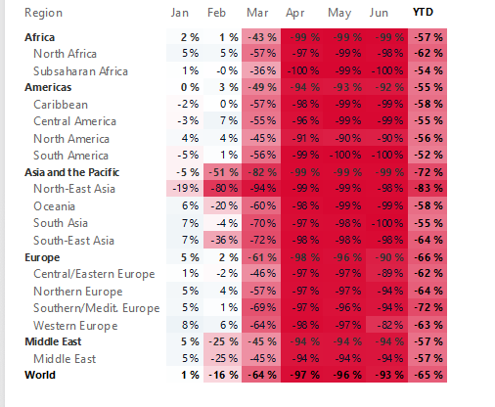
COVID19 Impact
International tourists' arrivals fell 65% during first half of 2020 (WTO, 2020)
The world’s tourism sector could lose at least $1.2 trillion, or 1.5% of the global gross domestic product (GDP) (UNCTAD 2020)
Source: https://www.unwto.org/unwto-tourism-recovery-tracker

Slide 6
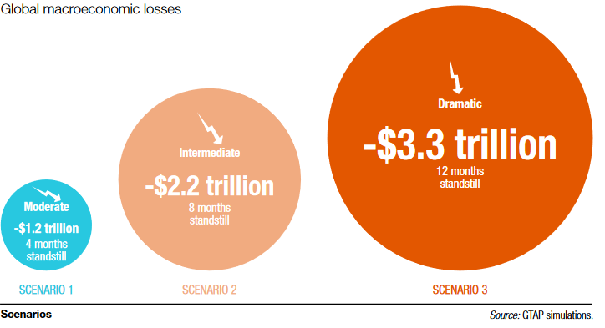
Global Macroeconomic losses
Notes:
The impact of the pandemic on tourism can generate a potential global GDP decline of 1.5 to 4.2% depending on whether we take a moderate, an intermediate or a full impact scenario (UNCTAD, 2020).
In tourism-dependent countries, one million lost in international tourism revenue will signify a 2 to 3 million in the country’s national income.

Slide 7
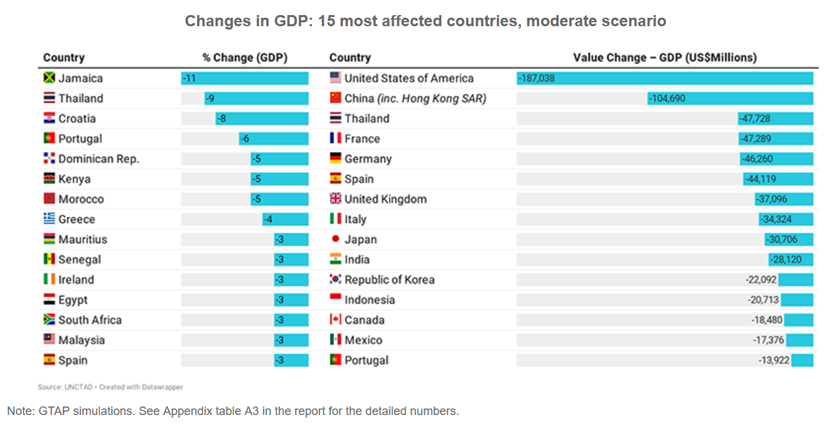
Change GDP: 15 most affected countries, moderate scenario

Slide 8
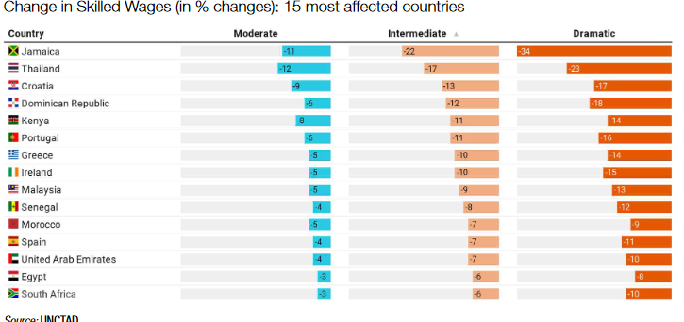
Change in Skilled Wages (in % changes): 15 most affected countries

Slide 9
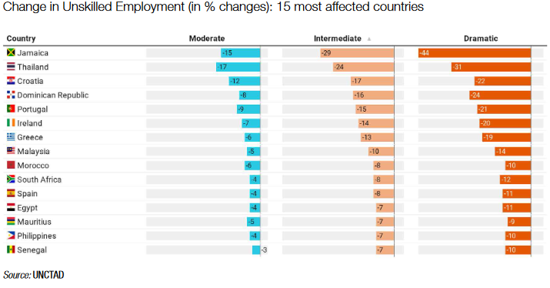
Change in Unskilled Employment (in % changes): 15 most affected countries

Slide 10
Examples measures taken to respond to covid-19 pandemic in the coastal tourism sector
 | Testing | Quarantine | Transport | Hotels | Social support | Other
Greece | √ Targeted & random pre-entry | Not required for visitors with negating result test before arrival | √ Passenger locator form | √ Ministry of tourism Protocols for safe services. Special requirements for hotels with + 50 rooms | √ Unemployment benefits extended to seasonal workers. √ Seasonal workers & SMEs affected.
Barbados | √ All travelers but those from low risk countries must be tested √ Mandatory retest for travelers from medium & high-risk countries | √ Self isolation for self positive cases √ Mandatory for 7 days for ttravellers from high-risk countries | √ Travel reopen 12 of July 2020 √ Online immigration/customs form Health screen √ Travel and safety protocols | √ Stay safe and worry-free policy by oceans hotels | √ Social Security Deferral √ Welfare Support | √ $200 Million Recovery Fund For Tourism (Barbados Tourism Fund Facility) √ Visa schemes for teleworking
Thailand | √ All travelers must be tested | √ 14 Day quarantine & new testing after √ Safe and Sealed programme | √Special tourist visa | √ COVID-19 Prevention Guidelines for Hotels by Thai Hotel Association | √ Compensation for force majeure & leave without pay schemes. √ Migrants particularly affected | √ Public support for domestic travel
South Africa | √ All travelers must be tested |  | X Tourism travel closed. International travel will reopen from 01 Oct 2020 subject to regulations | √ Tourism Business Council has developed comprehensive protocols for tourism facilities | √ Support for SMEs & unemployed workers. √ Unemployment linked to poaching. | √ COVID-19 Tourism Relief Fund
Notes:
Barbados:
https://www.visitbarbados.org/sysimages/fileupload/source/Covid/btmi%20travel%20protocols%20updated%20240920[10][3][3].pdf
https://home.kpmg/xx/en/home/insights/2020/04/barbados-government-and-institution-measures-in-response-to-covid.html
https://www.imf.org/en/News/Articles/2020/08/28/pr20289-barbados-imf-staff-concludes-virtual-visit
https://www.visitbarbados.org/covid-19-travel-guidelines-2020
https://www.southbeachbarbados.com/covid-19-update
The Barbados Tourism Fund Facility will be a loan entity designed to provide urgent working capital, investment loans, and where possible blended finance for the upgrade of Barbadian hotels and tourism businesses.
Greece:
https://travel.gov.gr/#/
https://news.gtp.gr/2020/05/22/greek-hotels-health-protocols-post-covid-19-restart-officially-announced/
https://news.gtp.gr/2020/03/20/greeces-seasonal-tourism-staff-receive-support-view-covid-19/
Thailand :
https://www.thailand-business-news.com/business/78663-7-million-jobs-at-risk-in-post-covid-19-thailand.html
https://edition.cnn.com/travel/article/thailand-reopening-safe-and-sealed-covid/index.html
http://www.thaihotels.org/17191900/covid-19-prevention-guidelines-for-hotels
https://www.tourism-review.com/thailands-tourism-expecting-aid-from-government-news11600
https://www.scmp.com/magazines/post-magazine/travel/article/3099669/thailands-safe-and-sealed-strategy-attracts-time-and
South Africa :
https://www.gov.za/covid-19/individuals-and-households/travel-coronavirus-covid-19
https://www.southafrica.net/gl/en/trade/page/coronavirus-covid-19-south-african-tourism-update
https://www.traveldailynews.com/post/south-africa-tourism-invites-eligible-companies-to-apply-for-the-coronavirus-covid-19-tourism-relief-fund
https://www.southafrica.ch/357-travel-advisory-in-response-to-the-covid-19-pandemic.html

Slide 11
Short term measures
Mix of government and private sector interventions to avoid coastal tourism SMEs bankruptcy
Support to assist vulnerable populations (women, migrants, and seasonal workers) in benefiting from social protection or to move towards a other economic activities
Support tourism sector shifting towards to new markets (e.g. domestic)
Implementation of measures/protocols to ensure safe tourism for both tourists and countries at key transport/transfer points and during their stay
Notes:
In the short term, a mix of government and private sector interventions will be needed to avoid coastal tourism SMEs bankruptcy (reducing interest rates or by extending loans) and provide income support for vulnerable populations (unemployment support)
Support will also be needed to assist vulnerable populations in shifting economic activity temporary or permanently toward less affected sectors such as food production, health, telecommunications and e-commerce services.

Slide 12
Medium- and Long-Term measures
International cooperation (to protect people from contagion across borders)
Make recovery programmes BLUE
Promote economic diversification (although difficult in some countries)
increased regional integration
make use of e-marketing tools
education and training programmes in targeted economic sectors
Invest in the sustainability of other blue economy sectors (e.g. aquaculture, renewable off-shore energy, marine R&D)
Notes:
International cooperation will be needed for tourist recipient countries to be able to protect tourists and to establish relevant sanitary measures in hotels, restaurants and other relevant establishments in order to avoid risks of contagion.
In the medium and long term, it is necessary for government to implement measures aimed at diversifying the economy, where possible. A high dependence on one sector increases vulnerability. Avenues for economic diversification may include increased regional integration, education and training programmes in targeted economic sectors to boost resilience and mitigate the cost of shocks.

Slide 13
Thanks

